Slide 1
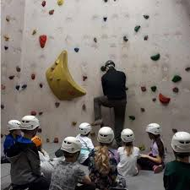
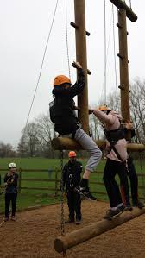

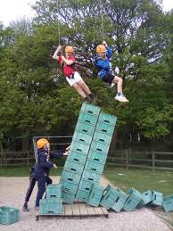
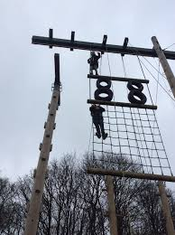

Laches Wood September 2026

Slide 2
Our Year 6 residential trip to Laches Wood will be
Wednesday 16th – Friday 18th September 2026
The cost of the trip is heavily subsidised by school and payments can be made over time as needed via ParentPay.
The accommodation, food, travel and activities will cost the school £190 per child.
The cost per child to families will be £130.

Slide 3
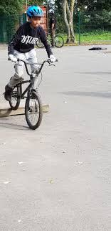



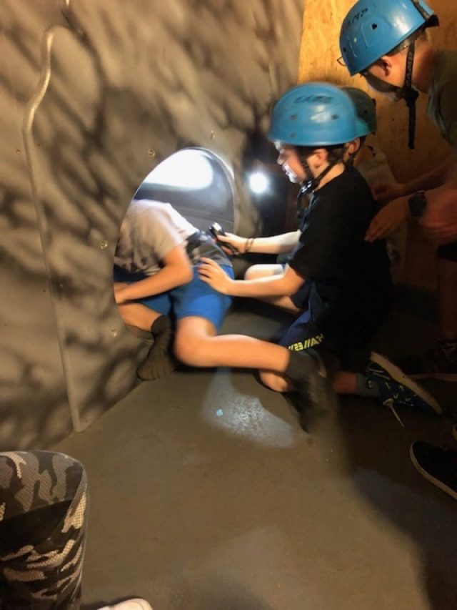
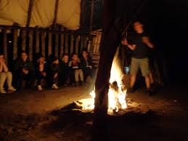
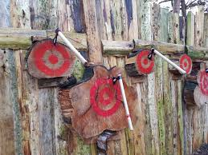
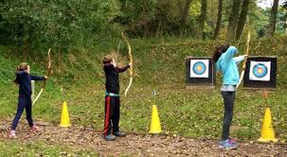
Some of the activities may include;
We will be advised closer to the time of our exact itinerary.

Slide 4
Wednesday 21st January 2026
Wednesday
Thursday
Friday
1
Look at the website – there will be a Laches Wood 2026 tab.
2
We will send you a brief update via Arbor App Messages to confirm that we have arrived.
3
We will load photographs to the website
(those with permission only)
4
We will inform you via email as we leave so that you have the estimated arrival time.
5
You communicate with school as usual
1
Leave Laches Wood at approximately 1:30pm
2
School will email you that we have left.
3
Arrive at school by
3 pm.
4
Collect children from the coach.
Enjoy the weekend.
1
Arrive at school in non-uniform at normal time. With your SOFT bag that you can carry!
2
Parents help children ‘check-in’.
3
Children head straight to the KS2 hall or car park – dependent on weather.
4
Give in snack, medication and souvenir money to the teachers
5
Coach will arrive at around 9.00am.
6
Off we go…..

Slide 5
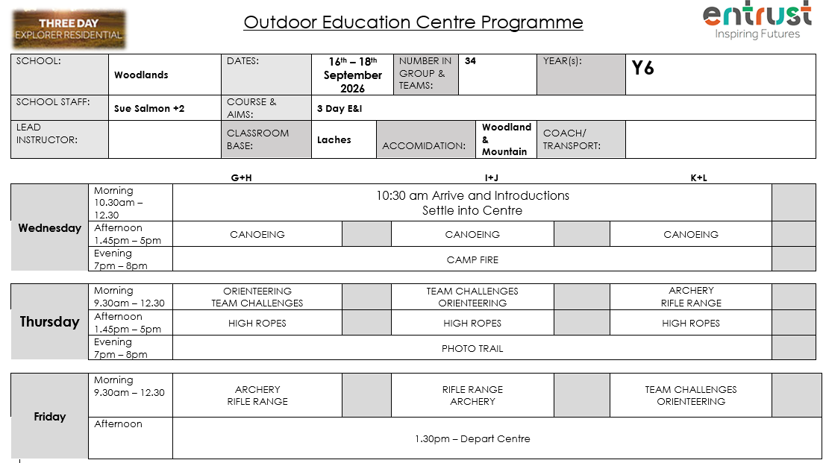

Slide 6
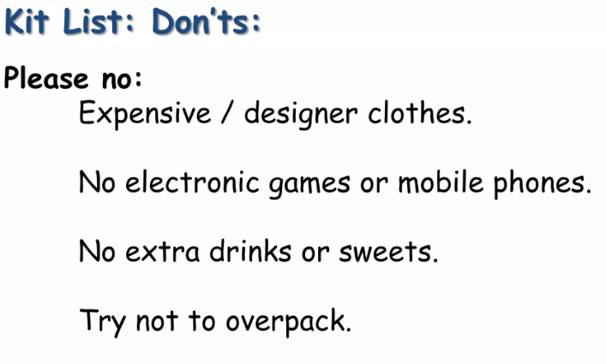


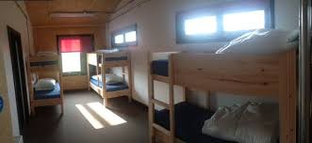

Other arrangements
Dormitories
Food

Slide 7
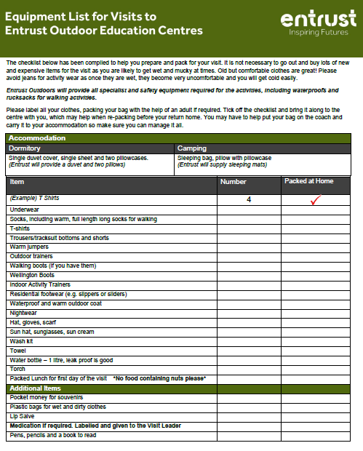
Please pick your copy today before you leave.

Slide 8

This is the example menu as it is now.
This may change in September but it gives you an idea.

Slide 9
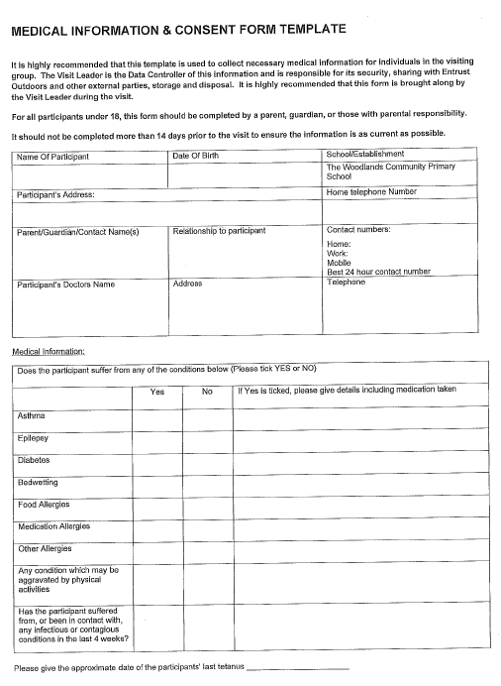

This medical and consent form will come out to you in September.
It will need to be handed in to school by Friday 11th September.
Any ‘live’ medication can be handed in to Mrs Read on the day we leave.

Slide 10
Wednesday 21st January 2026
Wednesday
Thursday
Friday
1
Look at the website – there will be a Laches Wood 2026 tab.
2
We will send you a brief update via Arbor App Messages to confirm that we have arrived.
3
We will load photographs to the website
(those with permission only)
4
We will inform you via email as we leave so that you have the estimated arrival time.
5
You communicate with school as usual
1
Leave Laches Wood at approximately 1:30pm
2
School will email you that we have left.
3
Arrive at school by
3 pm.
4
Collect children from the coach.
Enjoy the weekend.
1
Arrive at school in non-uniform at normal time. With your SOFT bag that you can carry!
2
Parents help children ‘check-in’.
3
Children head straight to the KS2 hall or car park – dependent on weather.
4
Give in snack, medication and souvenir money to the teachers
5
Coach will arrive at around 9.00am.
6
Off we go…..

Slide 11


