Slide 1
Wow Assembly:
Friday ^{13th} May

Slide 2
Phrase of the Week:

Slide 3
Green Cards!
Aspen- Amber
Kacper
Erin
Eydie
Redwood – Caeden
Evelyn
Ellie-Mae
Maple- Max
Ayla
Finley

Slide 4
Scientists of the Week!
Oak – Isabelle
Ash –
Birch – Poppy
Pine – Lily-Ann
Elm – Austin
Willow – Riley WP
Spruce – Kai
Maple – Oscar
Redwood – Liam V
Chestnut –
Aspen-Erin

Slide 5
Weekly Team Points!
Peel | Ethelfleda | Grazier | Offa
183 | 248 | 236 | 274

Slide 6
Oak
Isla-Rose
For
Fantastic home reading and independent reading in class.
Mrs Laffan 13.05.22

Slide 7
Ash
George
For super spatial reasoning work with shapes.
Miss Bailey and Mrs Salt 13.05.22

Slide 8
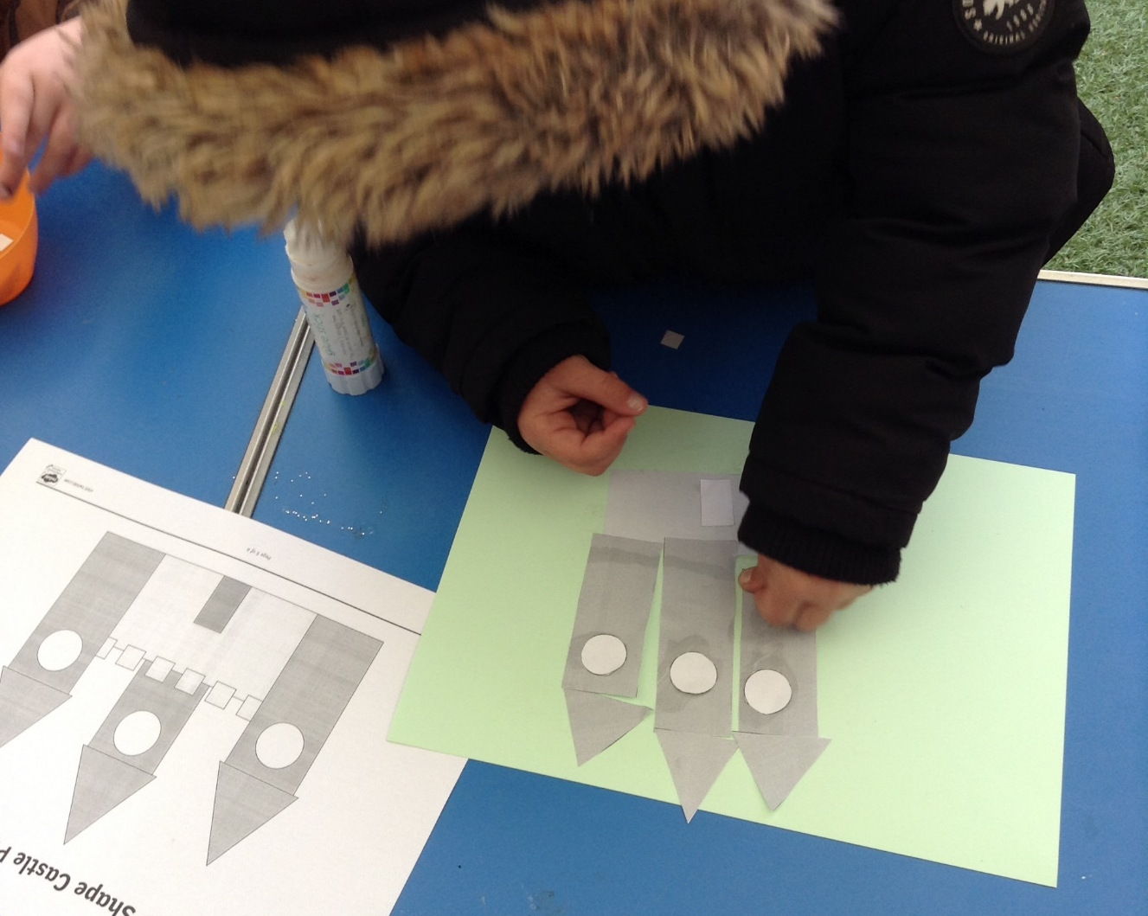
Ash Wow Work

Slide 9
Elm
Edward-Daniel
For showing passion within music. Edward was moving to the pulse of the music and was able to represent the rhythm of the music with his actions – You could be a pop star! Great Musicality Edward.
Mr Grice 13.05.2022

Slide 10
Birch
For
Harrison and Idris
Well done Harrison and Idris for being the first children to pass their Bronze Award in Birch! Very impressive! Well done ☺
Miss Hewitt 13.05.22

Slide 11
Pine
Harriet
For using excellence in presentation across all subjects. It is outstanding.
Mrs Leedham-Hawkes 13.05.22

Slide 12
Maple
Louie Jay T
For improving his score on the multiplication check. Keep it up Louie!
Miss Dawson 13.05.2022

Slide 13
Willow
Keira
For her increasing confidence in Reading. She is offering to read aloud and persevering and being resilient when coming across challenging vocabulary. Keep up the great work!!
Miss Fisher 13.05.22

Slide 14
Spruce
Harley
For working so hard and trying his best, not only this week but every week. Superstar!
Miss Volante 13.05.22

Slide 15
Chestnut
Everyone!!
For showing a mature attitude towards their SATs during this week. Everyone kept a positive attitude even when faced with some difficulties along the way.
Well done Chestnut!
Mr Tennuci 12.05.22

Slide 16
Aspen
Lilly Cotterill
For an amazing attitude towards her learning through out the week. Great perseverance.
Miss Bennett & Mrs Cox 10.09.21

Slide 17
Redwood
Isla
For demonstrating super self-awareness and passion in PSHE.
Keep up the great work!
Miss Shipley 13.05.22

Slide 18
Next Week’s
Phrase of the Week:
!

