Slide 1
Wow Assembly:
Friday 3rd December

Slide 2
Phrase of the Week:

Slide 3
Green Cards!
Violet - Aspen

Slide 4
Scientists of the Week!
Oak –Lincoln
Ash – Ronnie
Birch –
Pine – Jensen
Elm – Duke
Willow – Roux
Spruce – Ezmai
Maple –
Redwood –
Chestnut – Mimi
Aspen - Erin

Slide 5
Weekly Team Points!
Peel | Ethelfleda | Grazier | Offa
266 | 335 | 415 | 403

Slide 6
Oak
Olivia
For
Super information writing about a Polar Bear.
Mrs Laffan 03.12.21

Slide 7
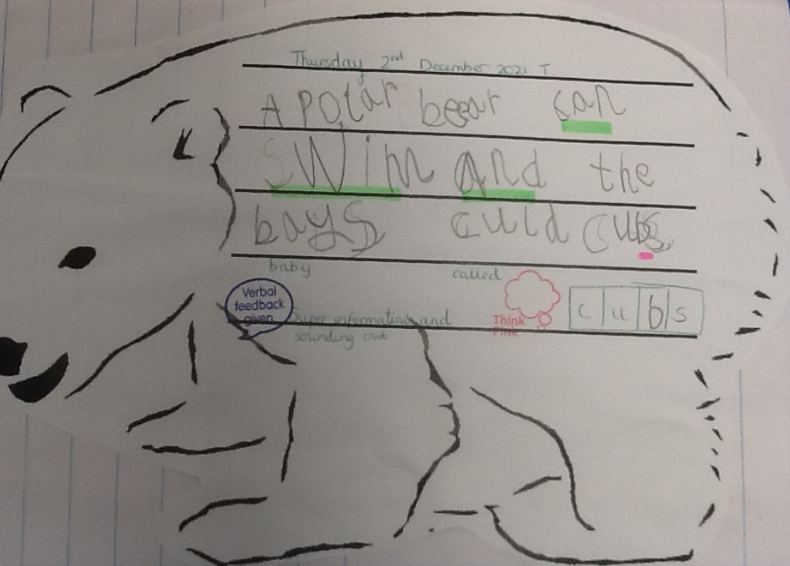
Oak Wow Work

Slide 8
Ash
Nyarai
For super writing
Miss Bailey and Mrs Salt 03.12.21

Slide 9
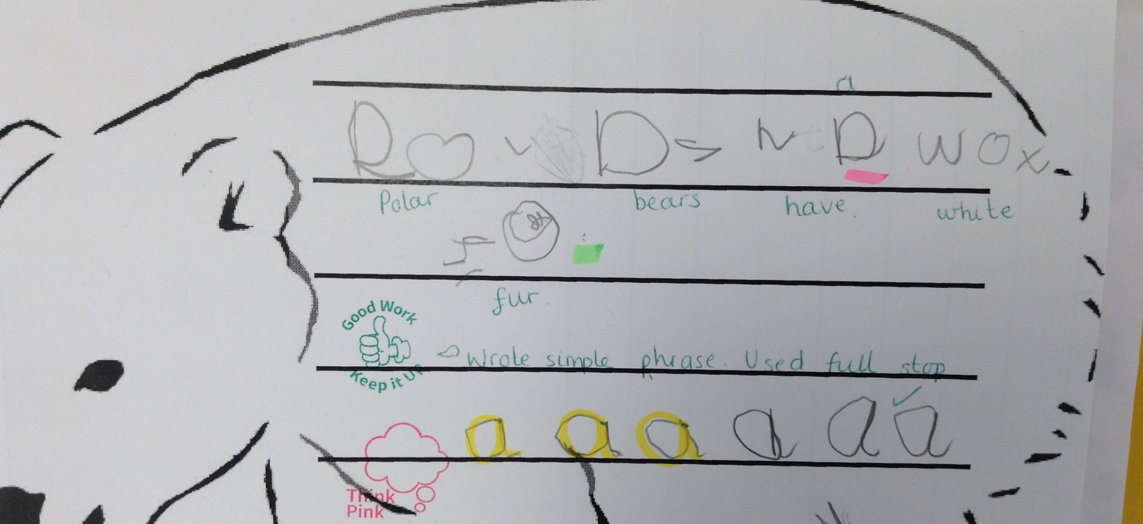
Ash Wow Work

Slide 10
Elm
Alaina
for putting in so much effort towards our nativity songs. Alaina you have sung beautifully and have always participated with out actions. Keep up your excellent theatrical skills! Well Done.
Mr Grice 02.12.2021

Slide 11
Birch
For
Everyone!
Well done to everyone in Birch for showing excellent resilience this week .Well done !
Miss Hewitt & Mrs Downs 03.12.21

Slide 12
Pine
Olivia
For using self-awareness to always show outstanding behaviour and learning attitudes in all aspects of school life. Well done! ☺
Mrs Leedham-Hawkes 03.12.21

Slide 13
Maple
Dexter
For a fantastic attitude towards his learning. Dexter has been starting his work independently so that he can complete tasks to the best of his ability.
Keep it up Dexter!!
Miss Dawson 03.12.2021

Slide 14
Willow
Betsy
For giving 100% in her learning and trying hard to tackle challenges independently in maths.
Miss Fisher 03.12.2021

Slide 15
Spruce
Cleo K
For being an inspiration to all learners, modelling great behaviours for learning and showing kindness to everyone in the classroom.
Mr Draper 03.12.21

Slide 16
Chestnut
Zac
For his resilience and perseverance in maths this week. He has been challenged with his understanding of fractions and drawn on past learning to help him tackle more challenging problems.
Mr Tennuci 02.12.21

Slide 17
Aspen
Annalia
For writing fantastic sentences in English using accurate punctuation and adventurous vocabulary! Keep it up, so impressive! ☺
Mrs Read & Mrs Cox 03.12.21

Slide 18
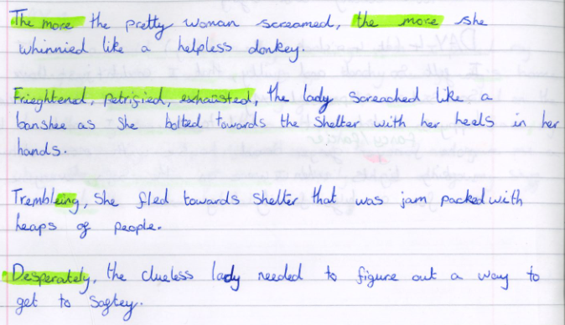
Aspen Wow Work

Slide 19
Redwood
Kieran
For showing fantastic resilience in his Big Write and challenging himself to include lots of features of a narrative
Miss Shipley 03/12/21

Slide 20
Next Week’s
Phrase of the Week:
!

