Slide 1


Slide 2

AD43
The Roman conquest begins.
Roman soldiers were drawn from all over North Africa and Europe.

Slide 3
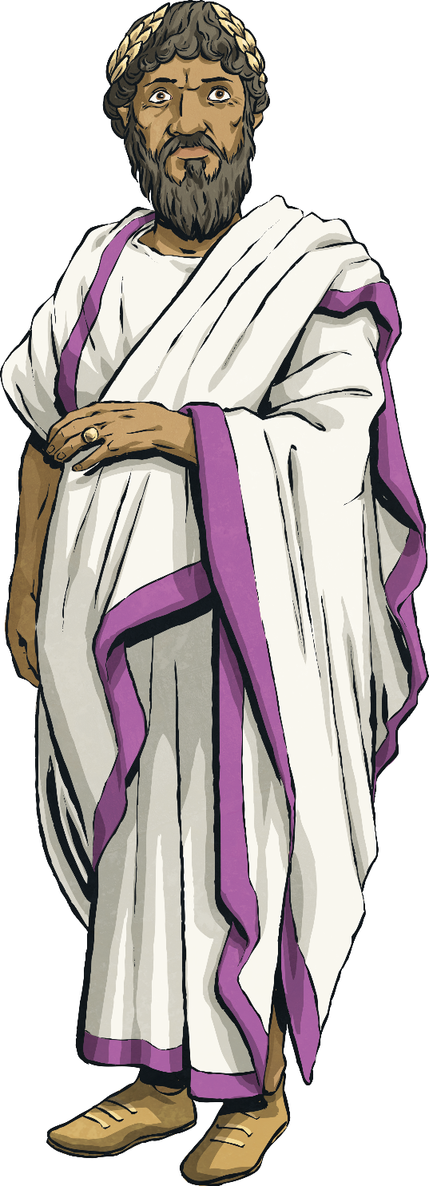
193
Septimus Severus becomes the first
Black Roman emperor.
Severus ruled Rome with the support of the
military and waged campaigns in Caledonia (Scotland), Byzantium and anyone who threatened his position as emperor. He lived in Eboracum
(York) for three years before his death in AD 211
at the age of 65.

Slide 4
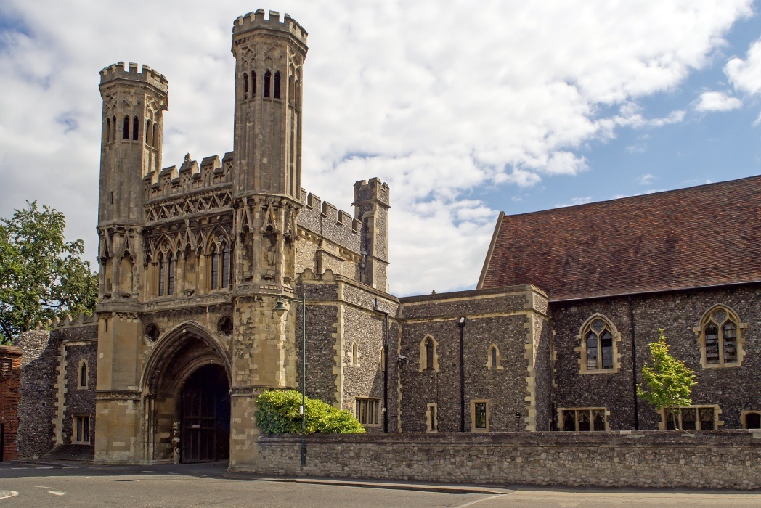
668
A Black scholar becomes abbot of an abbey in Canterbury.
Abbot Hadrian, who was an African-born scholar and noted teacher, became abbot of St Augustine’s Abbey, Canterbury.

Slide 5
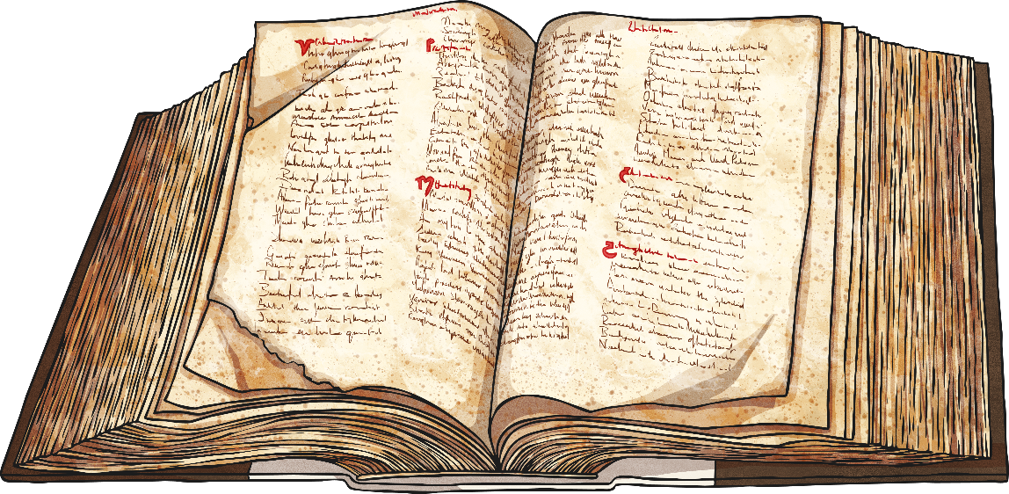
1241
Historical public records show a drawing of a Black Briton.
The earliest known drawing of a Black Briton was made in the Domesday Book.
The Domesday Book - compiled in 1085-6 is the earliest public record of the national archives and is valid as evidence of title to land.

Slide 6

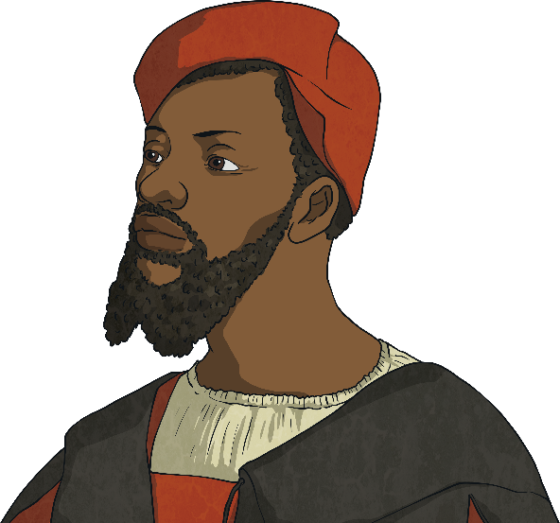
1507
1508
Historical public records show a drawing of a Black Briton.
Evidence of Black people in Britain found in poetry.
John Blanke, an African trumpeter recorded at Henry VII’s court.
A poem written by William Dunbar, called Ane
Blak-Moir, tells us that there were Black people in Britain at that time.

Slide 7

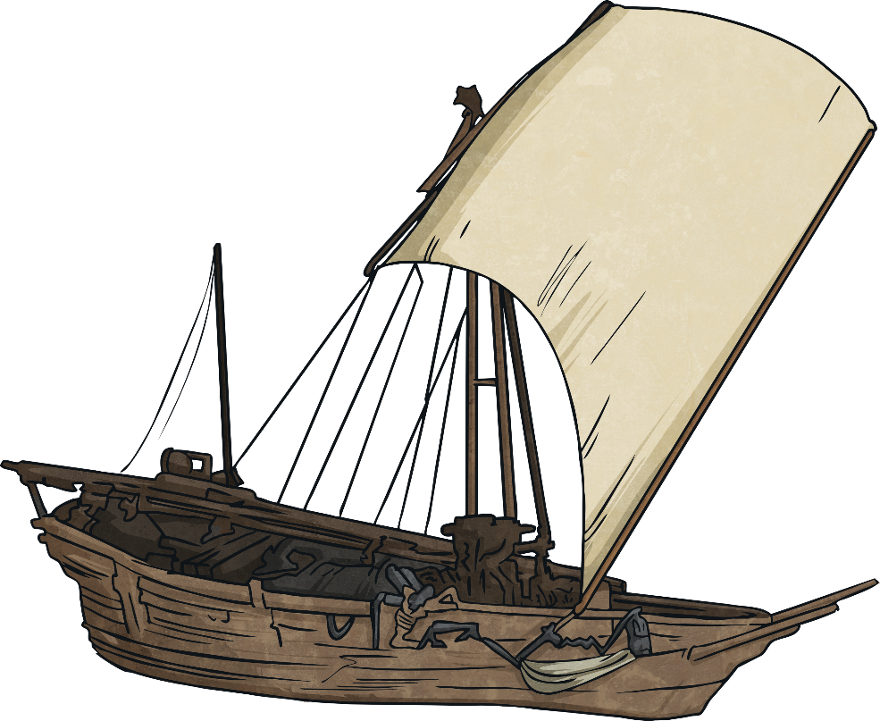
1555
Africans brought to Britain to help.
A group of people from Africa were brought to Britain to learn English so that they could act as interpreters for English traders.

Slide 8
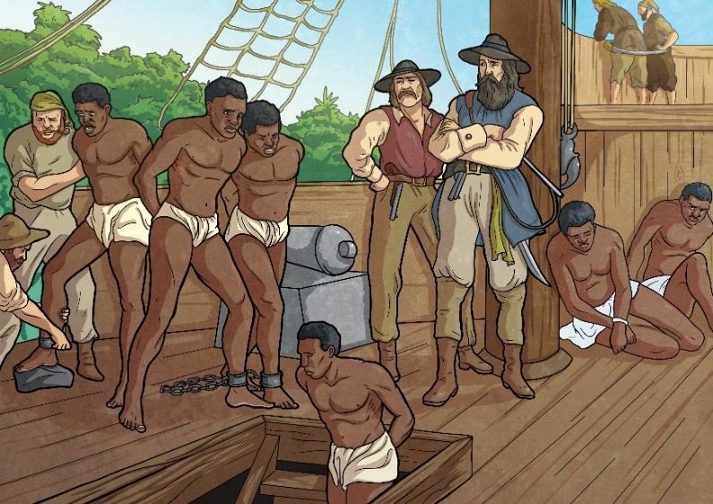
1672
1700s
The Royal African Company is formed in England to manage the English slave trade.
The number of enslaved people, servants and seamen increases.
Throughout the 1700s, the population of the Black and Asian enslaved people, servants and seamen increased.

Slide 9
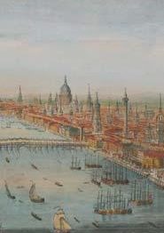
1760s
20,000 Black people living in Britain.
In the 1760s, 20,000 Black people were living in Britain, including up to 15,000 in London.
Black people were often shown and written about as less than human.

Slide 10

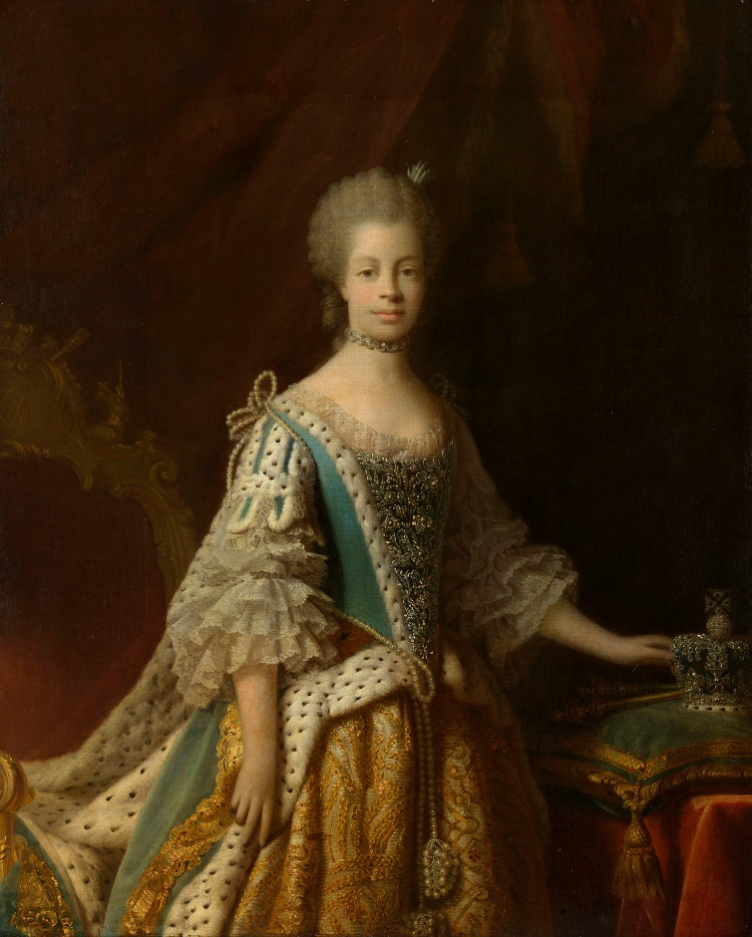
1761
Queen Sophie Charlotte marries King George III.
She was the first Black Queen of England, having African ancestry.
Charlotte had a number of interests, including music and botany, and she opened several orphanages during her 57 years as queen.
Charlotte’s portraits were often painted to soften her African features, although the Queen’s favourite portraits were ones that showed her more true likeness

Slide 11
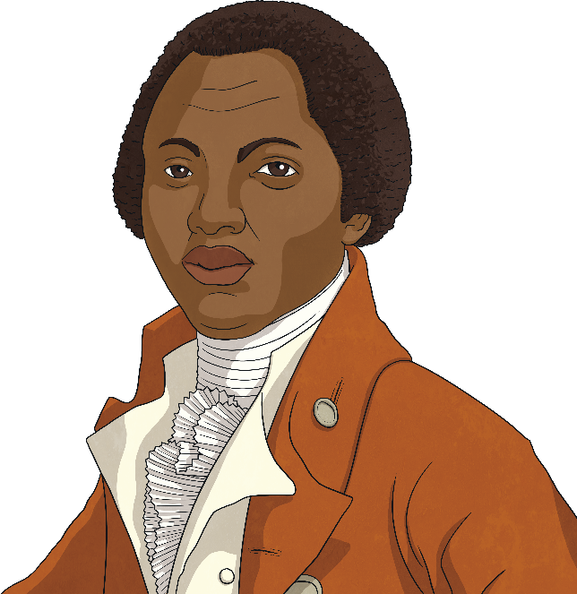
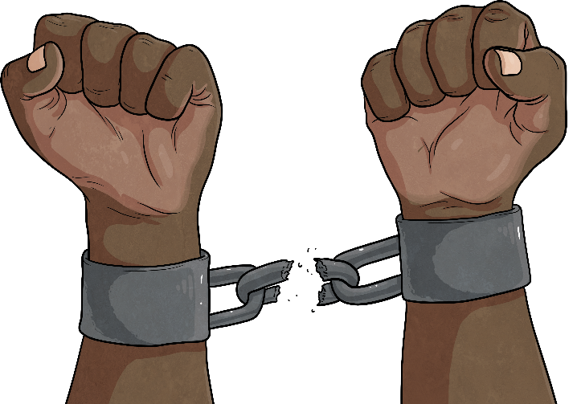
1765
1772
The campaign for the freedom of enslaved people begins in Britain.
A decline in slavery begins in England.
Olaudah Equiano was enslaved at the age of 11 and eventually bought his freedom. He campaigned for the abolition of slavery with the ‘Sons of Africa’ and would go on to write and publish his autobiography detailing his experiences as an enslaved person.

Slide 12
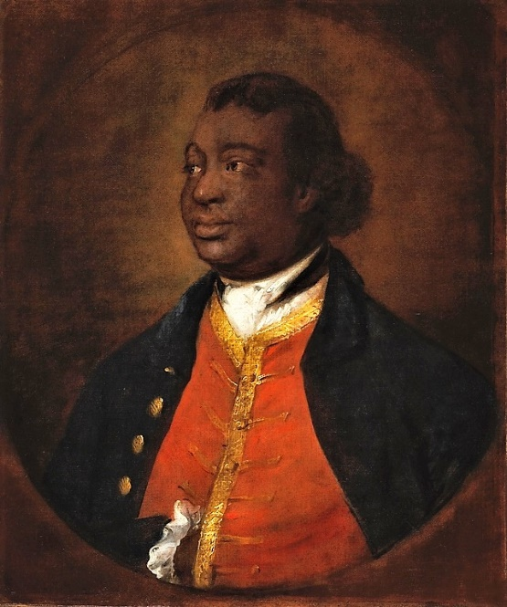
1774
First record of a Black British voter.
Ignatius Sancho, born on a slave ship and taken from his parents to work as a servant in Greenwich, was the first known Black person to vote in a British general election.
He taught himself how to read and write and immediately began speaking out against the slave trade, as well as learning how to compose music and write poetry on the subject.
In 1773, he set up a grocery shop in Westminster, making him eligible to cast a vote in the 1774 and 1780 elections.
He also wrote, acted and composed, as well lobbied
for the slave trade to be abolished.

Slide 13
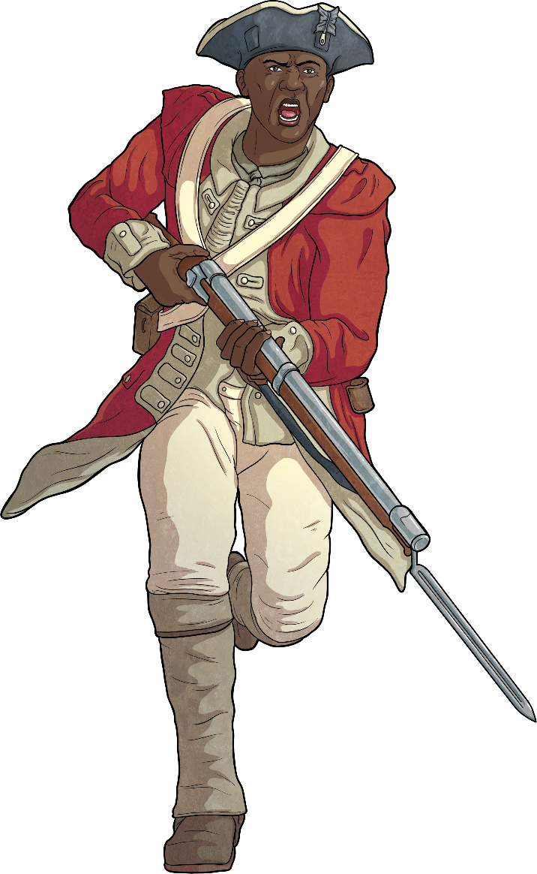
1775 - 1783
Black slave soldiers forced to beg on the streets.
Black American slave soldiers, who fought for Britain in the American Revolutionary War, arrived in London. However, they had no money and were forced to beg on the streets.

Slide 14

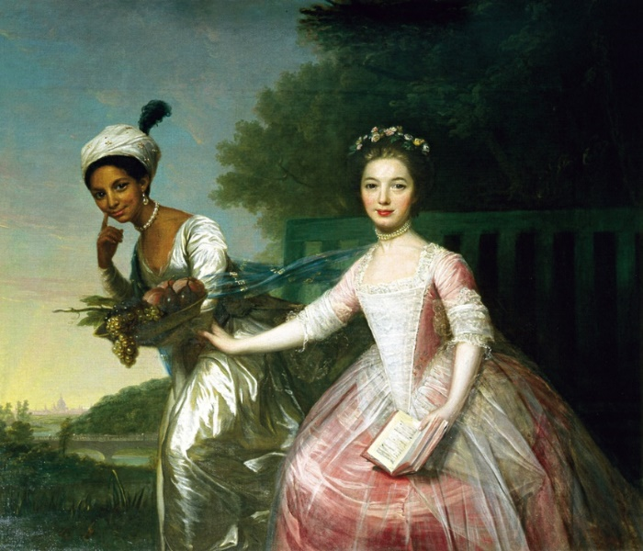
1779
First portrait showing a Black British aristocrat and heiress is painted.
This famous portrait shows Dido Elizabeth Belle and her cousin together as equals, which is highly unusual for 18th century British art. Dido’s aristocratic upbringing is apparent in her expensive silk gown and pearl necklace.
Dido was raised as part of an aristocratic family in Georgian Britain. She was born in the Caribbean in 1761 but spent much of her life at Kenwood House on Hampstead Heath in North London. She lived there with her great-uncle William Murray, 1st Earl of Mansfield, the Lord Chief Justice.
She was brought up as a lady rather than as a servant and was taught to read, write and play music.

Slide 15
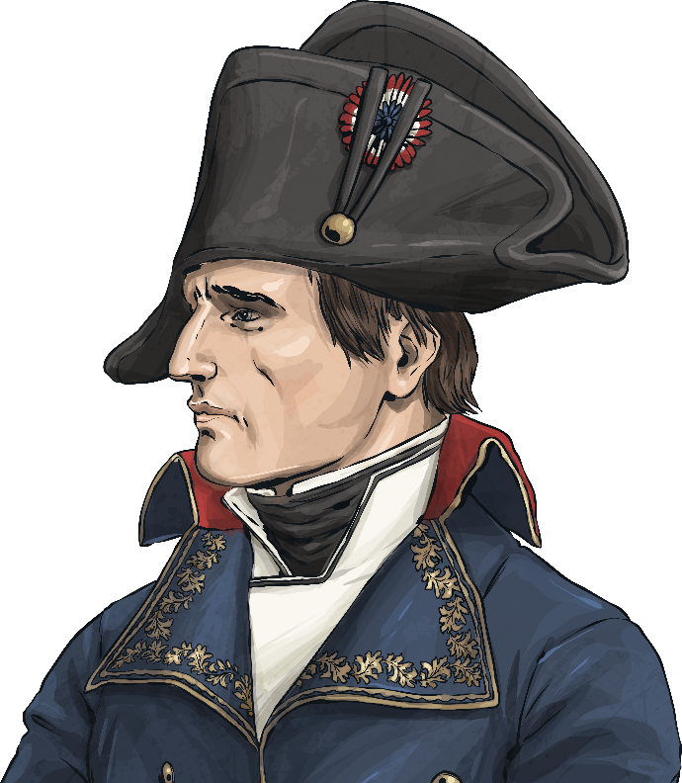
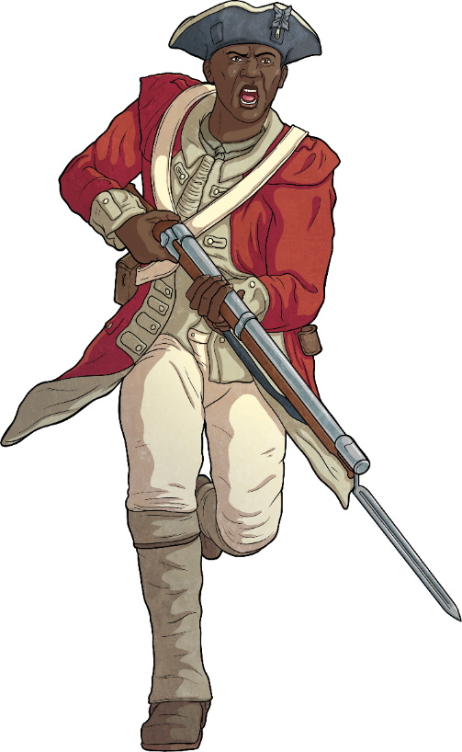
1792 - 1815
Black soldiers in London after the Napoleonic Wars.
Black soldiers and seamen settled in London
after fighting in the Napoleonic Wars.

Slide 16

1833
The Slavery Abolition Act becomes law in Britain.

Slide 17
1834
Decline in the Black population.
There was a decline in the Black population due to restrictions on immigration from Africa.

Slide 18
1855
Mary Seacole sets up her own hospital to care for wounded soldiers in the Crimean War.
Mary Seacole overcame racial prejudice to help others.
Although Mary had very good references, her offer of help during the Crimean War was turned down by the War Office because she was Black.
Despite this, she decided to pay for herself to get to Crimea and set up her own hospital just two miles from the fighting.

Slide 19
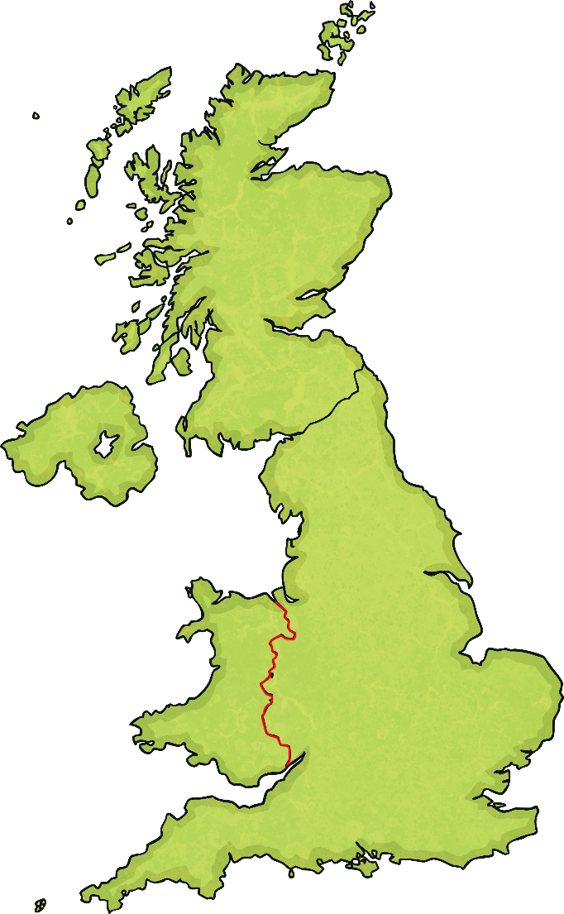
1880s
New Black communities are formed in Liverpool and Cardiff.
Small groups of Black dockside communities began to grow in ports, such as Liverpool and Cardiff.
Liverpool
Cardiff

Slide 20
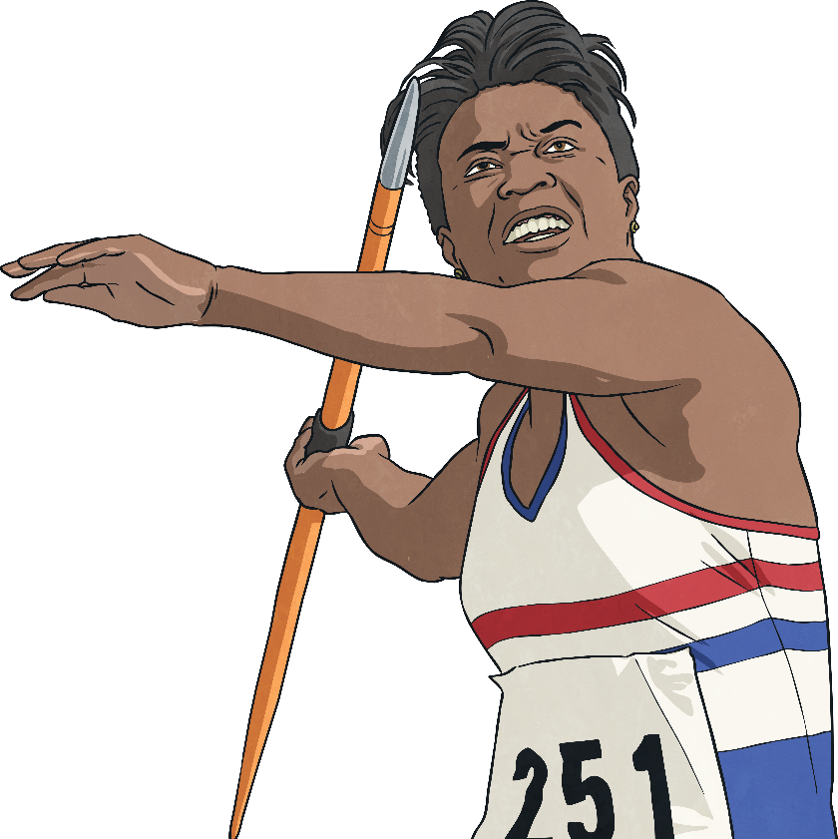
20th Century
Black people in Britain in the 20th century.
Tessa
Sanderson
Throughout the 20th century,
Britain saw an increase in
African students, professionals, businesspeople and athletes.

Slide 21
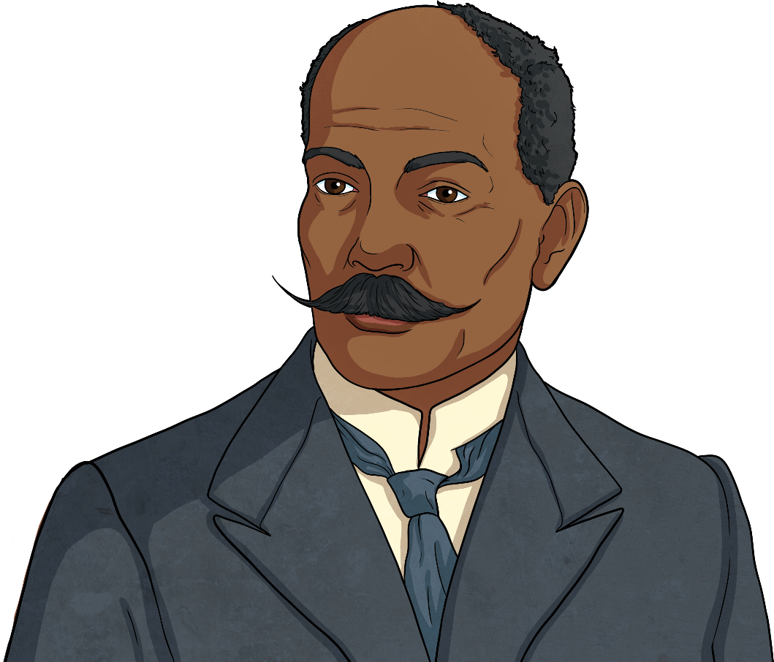
1913
First Black Mayor in London.
John Archer became Mayor of Battersea, the first Black mayor in London.

Slide 22

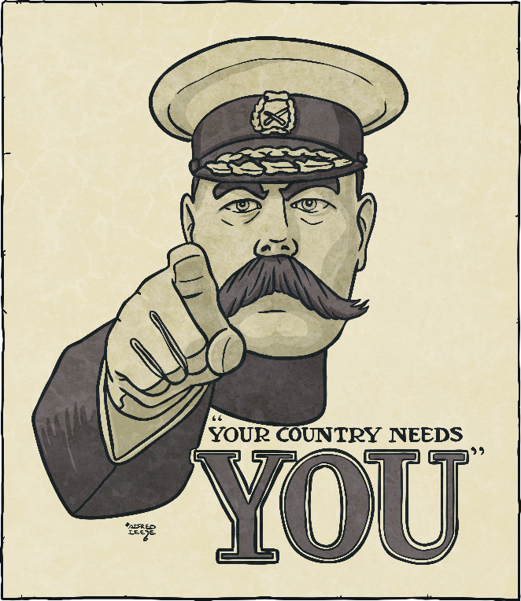
1914 - 1918
The First World War.
The First World War brought an influx of people from different countries around the world.

Slide 23
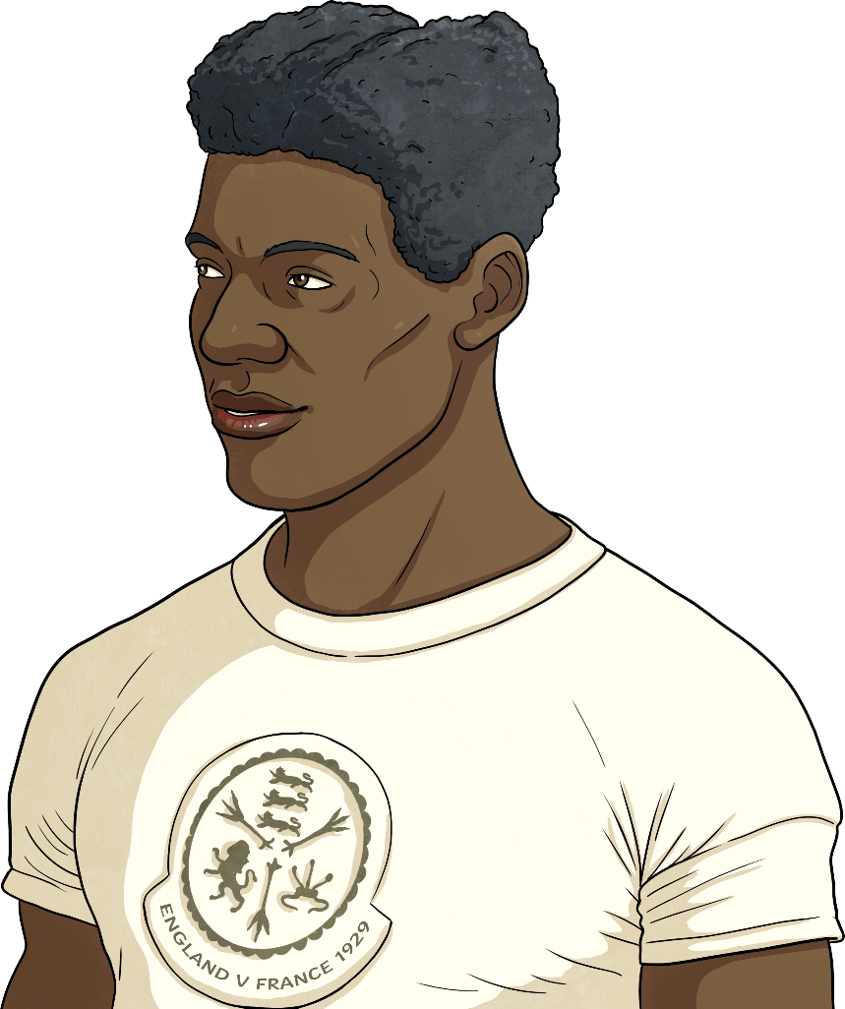

1928
The first Black athlete to win Olympic medals for Britain.
Jack London won silver and bronze medals at the Olympic Games in Amsterdam, gaining the silver medal in 100m sprint and the bronze medal for the 4×4 100m relay race.

Slide 24

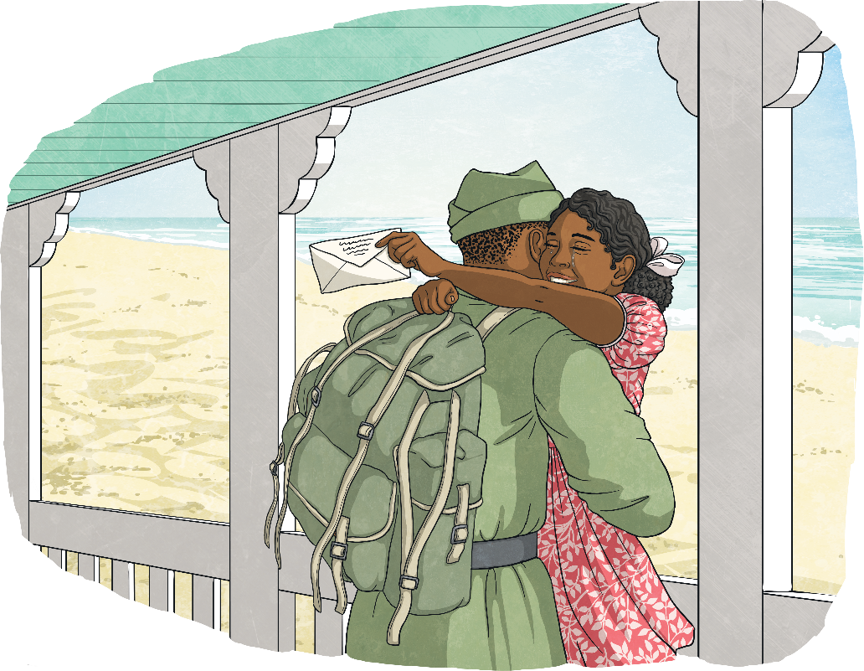
1939 - 1945
The Second World War.
People from the Caribbean and West Africa arrived as wartime workers and servicemen and women in the army, navy and air force.

Slide 25
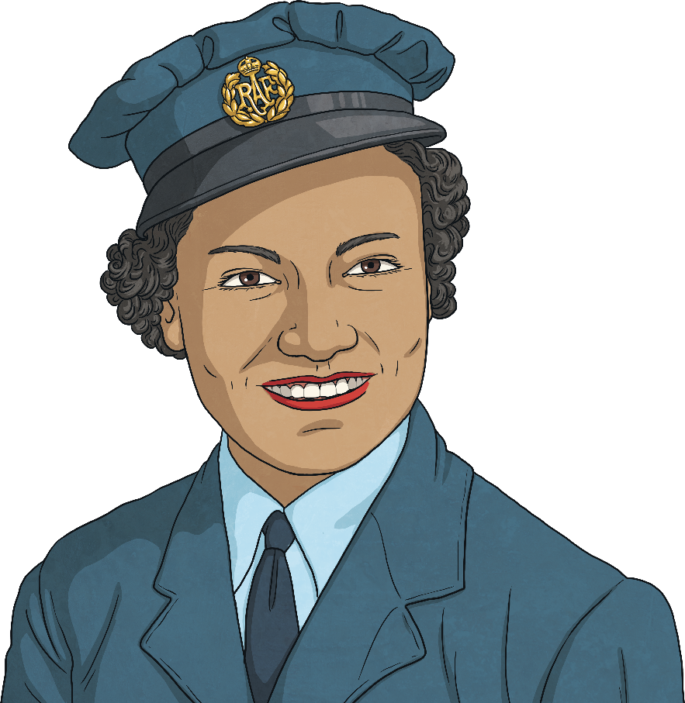
1941
Lilian Bader becomes one of the first Black British women to join the British Armed Forces.
After a number of setbacks, Lilian was accepted into the Women’s Auxiliary Air Force on 28th March 1941.
Later, she qualified as an Instrument Repairer, before becoming a leading aircraftwoman and soon afterward earned herself the rank of Corporal.
Three generations of her family went on to serve in the armed forces.

Slide 26
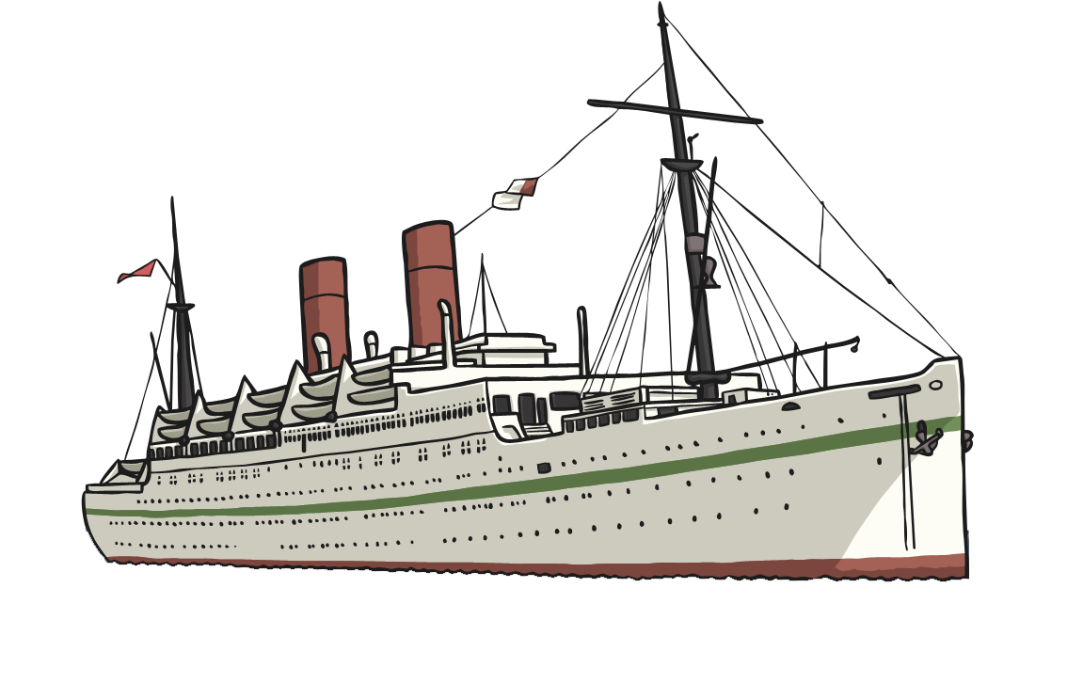

1948 - 1971
Large influx of workers come to Britain from the Caribbean.
During this time, a huge migration of people from all over the Caribbean came to work in hospitals and on transport and railway networks. They became known as ‘the Windrush Generation’ after the ship, the Empire Windrush.

Slide 27
1958 & 1996
Britain’s first major Black newspaper is founded.
In 1958, the West Indian Gazette was founded by Claudia Jones – a feminist, activist and journalist.
In 1966, she played a part in creating the Notting Hill Carnival which is held annually in August.

Slide 28
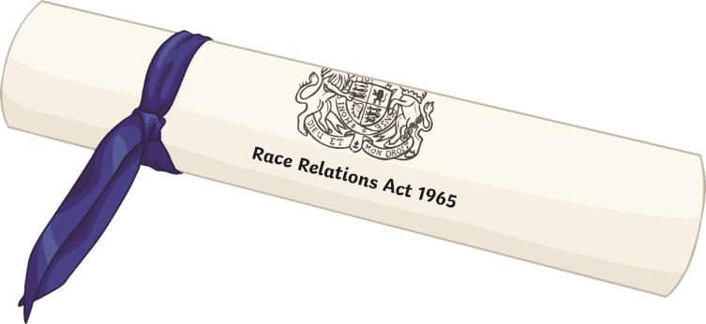
1965
The Race Relations Act.
The Race Relations Act was the first legislation in the U.K. to address racial discrimination. The Act banned discrimination on the "grounds of colour, race, or ethnic or national origins" in public places in Great Britain.
The act was amended in 1968 to include discrimination in employment, housing and advertising, and again in 1976
to include indirect discrimination. In 1976 the Commission for Racial Equality was established as a result of the Act.

Slide 29
1968
1972
Asian people settle in Britain.
Many Asian people were expelled from Kenya and settled in Britain.
Many Asian people were expelled from Uganda and settled in Britain.

Slide 30
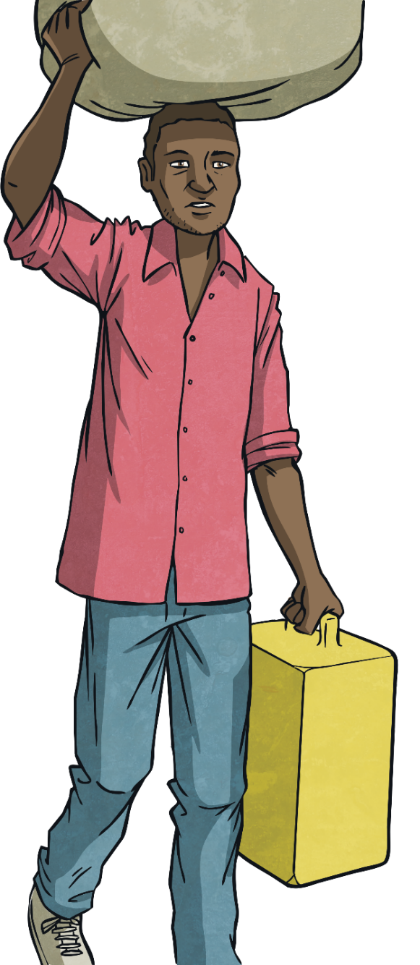
1980s
Somali refugees arrive in Britain.

Slide 31
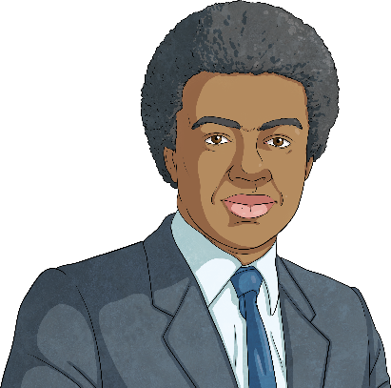
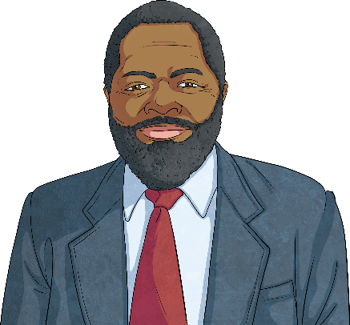
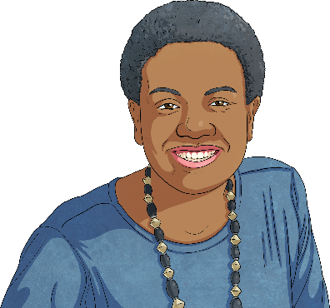
1987
The first Black Members of Parliament are elected.
Diane Abbott, Paul Boateng and Bernie Grant became the first Black MPs.

Slide 32
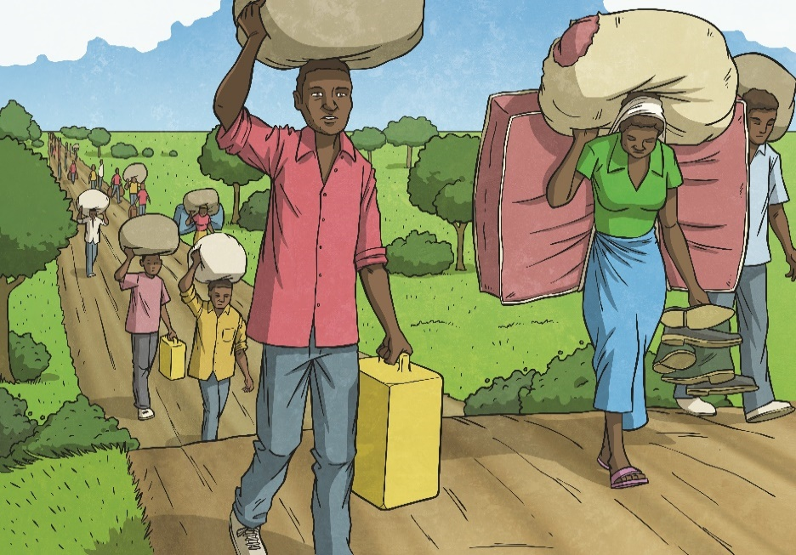
1993
The Asylum and Immigration Appeals Act is passed.
An Act to make provisions for people who claim
asylum in the United Kingdom and their dependants.
An asylum seeker is a person who has fled to another country from their home country because of war or other factors harming them or their family. They would then apply for asylum in this other country, which is to have international protection.

Slide 33
21st Century
Racism in Britain in general, including against Black people, is considered to have declined over time.
However, studies published in 2014 and 2015 claim racism is on the rise in the UK, with more than one third of those polled admitting they are racially prejudiced.

Slide 34
2001
2006
The Race Relations Amendment Act.
The Racial and Religious Hatred Act.
The Race Relations Amendment Act states that all public services must actively promote racial equality.
The Racial and Religious Hatred Act makes it illegal to stir up hatred against someone because of their race and religion.

Slide 35
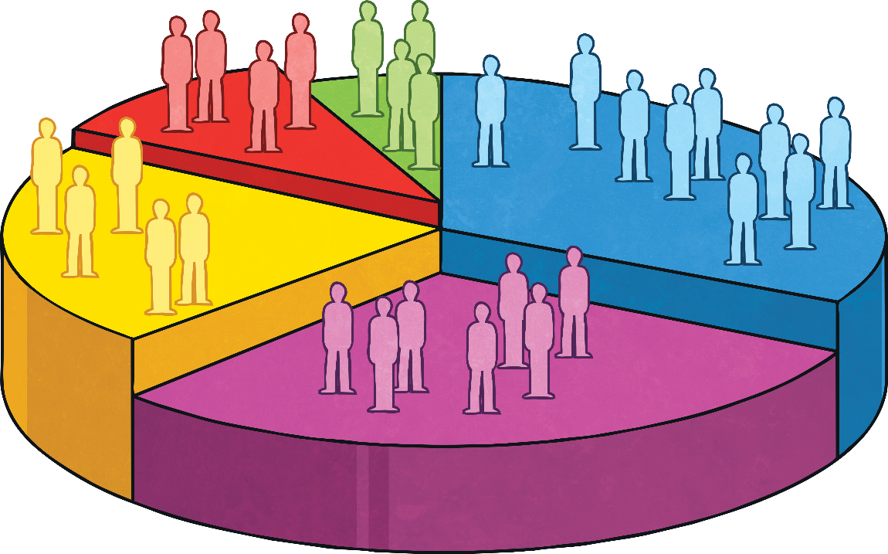
2011
3% of the British population are ‘Black, African, Caribbean or Black British’.
1,904,684 people (3% of the total population) recorded that they are ‘Black, African, Caribbean or Black British’ in the UK census.

Slide 36
2020
Thousands of people in Britain protest following the
killing of George Floyd by police in the United States.
In June 2020, the death of George Floyd in America inspired thousands of people in Britain to demand justice, marching through the streets of the UK and in many countries around the world.
These protests were accompanied by actions against memorials to people thought to be involved with the slave trade or other historic racism, including protests, petitions and vandalism of the memorials.

Slide 37
AD43 - 1555
193
Septimus Severus becomes the first Black Roman emperor.
668
African-born Abbot Hadrian becomes abbot of St Augustine’s Abbey, Canterbury.
1507
A Black trumpeter is recorded at Henry VII’s court.
1555
A group of Africans are brought to Britain to learn English so that they can act as interpreters for English traders.
1AD
1500
1600
1508
A poem written by William Dunbar, called Ane Blak-Moir, tells us that there were Black people in Britain at that time.
AD43
The Roman conquest begins. Roman soldiers are drawn from all over North Africa and Europe.
1241
The earliest known drawing of a Black Briton is made in the Domesday Book.
1672
The Royal African Company is created in England to manage the slave trade.

Slide 38
1700 - 1833
1760s
20,000 Black people live in Britain, including up to 15,000 in London. Black people are often shown and written about as less than human.
1772
A decline in slavery begins in England.
1792 - 1815
Black soldiers and seamen settle in London after fighting in the Napoleonic Wars.
1833
The Slavery Abolition Act becomes law in Britain.
1700
1800
1833
Black American slave soldiers who fought for Britain in the American Revolutionary War arrive in London but have no money and are forced to beg on the streets.
1800s
New Black communities are formed in Liverpool and Cardiff.
1700s
The population of the Black and Asian slaves, servants and seamen increases.
1765
The campaign for the freedom of slaves begins in Britain.

Slide 39
1834 - 1965
1855
Mary Seacole sets up her own hospital to care for wounded soldiers in the Crimean War.
1939 - 1945
People from the Caribbean and West Africa arrive as wartime workers and servicemen and women in the army, navy and air force.
1965
The Race Relations Act is passed and amended in 1968 and 1971.
1914 - 1918
The First World War brings an influx of people from different countries around the world.
1900
1948 – 1971
A huge migration of people from all over the Caribbean come to work in hospitals and on transport and railway networks. They become known as ‘the Windrush Generation’ after the ship, the Empire Windrush.
1834
There is a decline in the black population due to restrictions on immigration from Africa.
1941
First Black British women to join the British Armed Forces.
1913
John Archer becomes the first Black mayor of London.
1958
Britain’s first major Black newspaper is founded.

Slide 40
1965-2020
2011
1,904,684 people (3% of the total population) record that they are ‘Black, African, Caribbean or Black British’ in the UK census.
2001
The Race Relations Amendment Act states that all public services must actively promote racial equality.
1968-1972
Many Asian people are expelled from Kenya and Uganda and settle in Britain.
1980
2000
2006
The Racial and Religious Hatred Act makes it illegal to stir up hatred against someone because of their race and religion.
2020
Thousands of people in Britain protest following the killing of George Floyd by police in the United States.
1987
The first Black members of parliament are elected.
1993
The Asylum and Immigration Appeals Act is passed.
1980s
Somali refugees arrive in Britain.

