Slide 1
Wow Assembly:
Friday 2nd October

Slide 2
Phrase of the Week:
Success is a journey, not a destination!

Slide 3
Green Cards!
Bella– Willow
Riley W – Willow
Elizabeth-Birch
Ruby- Birch
Ellie-Birch

Slide 4
Scientists of the Week!
Birch – Ruby A
Pine – Tarron
Elm – Evelyn H
Willow – Eydie
Redwood – Grace S
Chestnut – Amelia M
Aspen-Ava

Slide 5
Weekly Team Points!
Peel | Ethelfleda | Grazier | Offa
190
195
153
171

Slide 6
Elm
Mikey S
For
A superb narrative story with amazing story language. Keep up the hard work Mikey!
Miss Brady 02.10.20

Slide 7
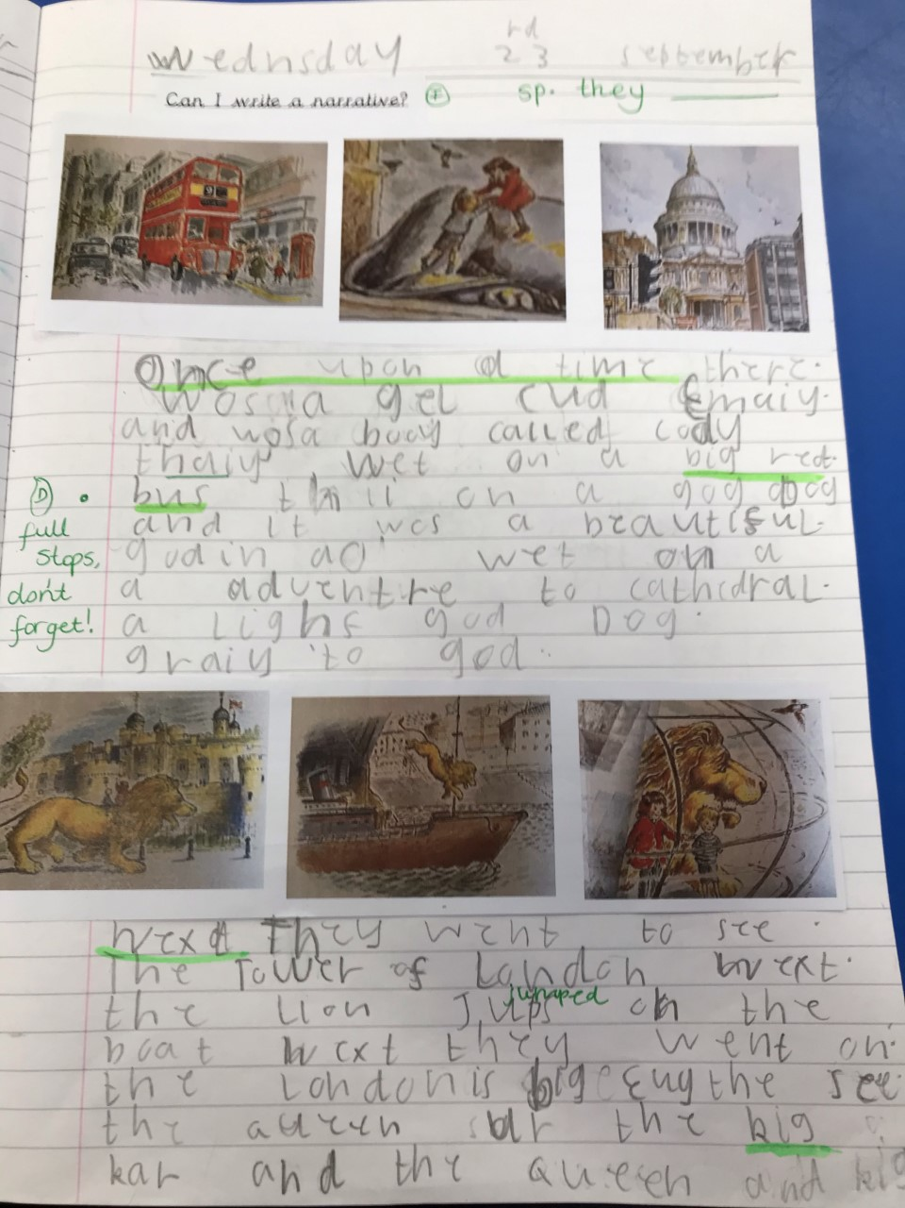
Elm Wow Work

Slide 8
Birch
Joshua
For
Trying hard with his English writing. Josh is reading his work to check it makes sense and is challenging himself with his vocabulary choices.
Miss Hewitt 02.10.20

Slide 9
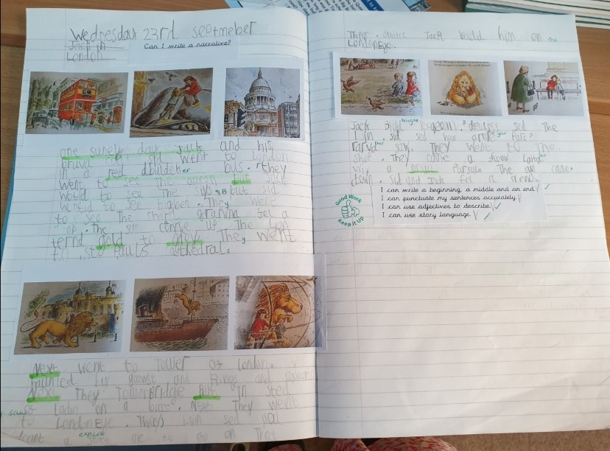
Birch Wow Work

Slide 10
Pine
Poppy
For using super adjectives to describe symptoms of the plague. Poppy tried so hard with her phonics to spell words. Well done!
Mrs Leedham-Hawkes 02.10.20

Slide 11
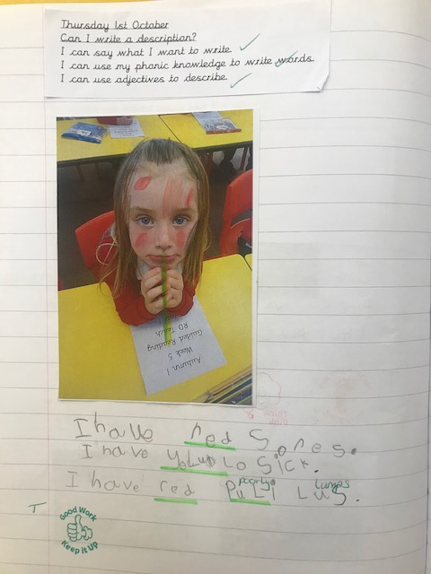
Pine Wow Work

Slide 12
Maple
Max W
For
A fantastic attitude to learning and trying hard to complete any activity set. Keep up the hard work Max ☺
Miss Dawson 02.10.20

Slide 13
Willow
Millie
For her confidence in outdoor PE.
Mrs Maiden and Miss Higgins 02.10.20

Slide 14
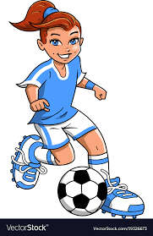
WillowWow Work
Millie amazed me in Football this week with her perseverance, confidence and skills.
She even volunteered to show the rest of the class.
Well done Millie ☺ Future footballer alert!!

Slide 15
Spruce
Amber
For
A great understanding of her previous and new maths objectives and using place value to add single digits to three digit numbers, which she is now working out mentally.
Mr Tennuci 02.10.20

Slide 16
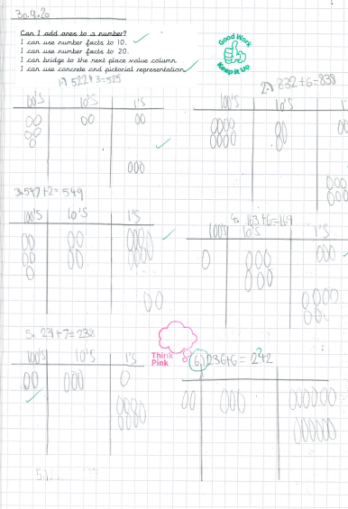
Spruce Wow Work

Slide 17
Chestnut
Alessia
For super independent work in Science and an improvement in presentation and handwriting. Well done Alessia!! Keep it up!
Miss Fisher 02.10.20

Slide 18
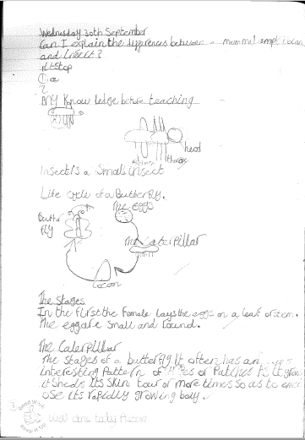
Chestnut Wow Work

Slide 19
Aspen
Emily
For superb algebra learning.
Mrs Davies 02.10.20

Slide 20
Aspen Wow Work
Emily has absolutely smashed algebra this week; even working on two unknowns. Go girl!

Slide 21
Redwood
George
For fantastic effort and resilience in his English work. He has shown excellent knowledge and understanding of the features of a newspaper article.
Miss Shipley 02.10.20

Slide 22
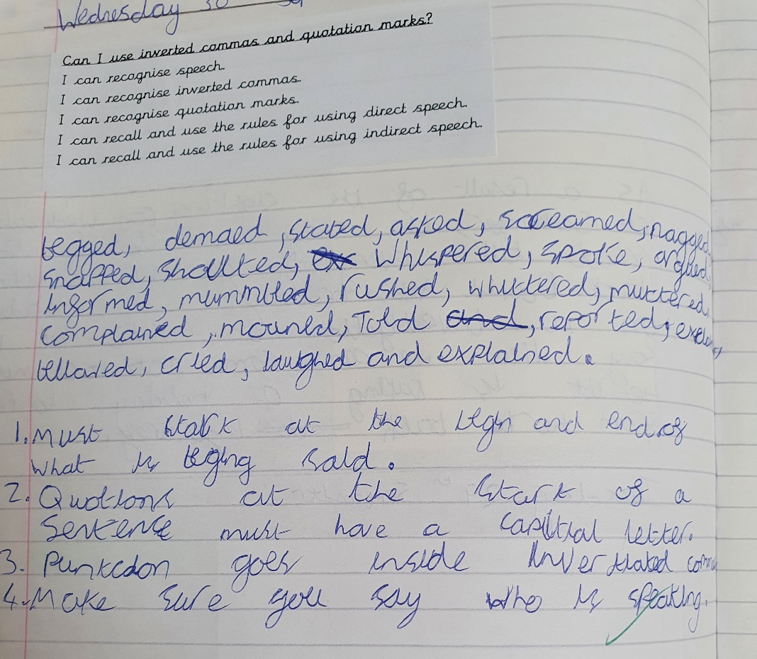
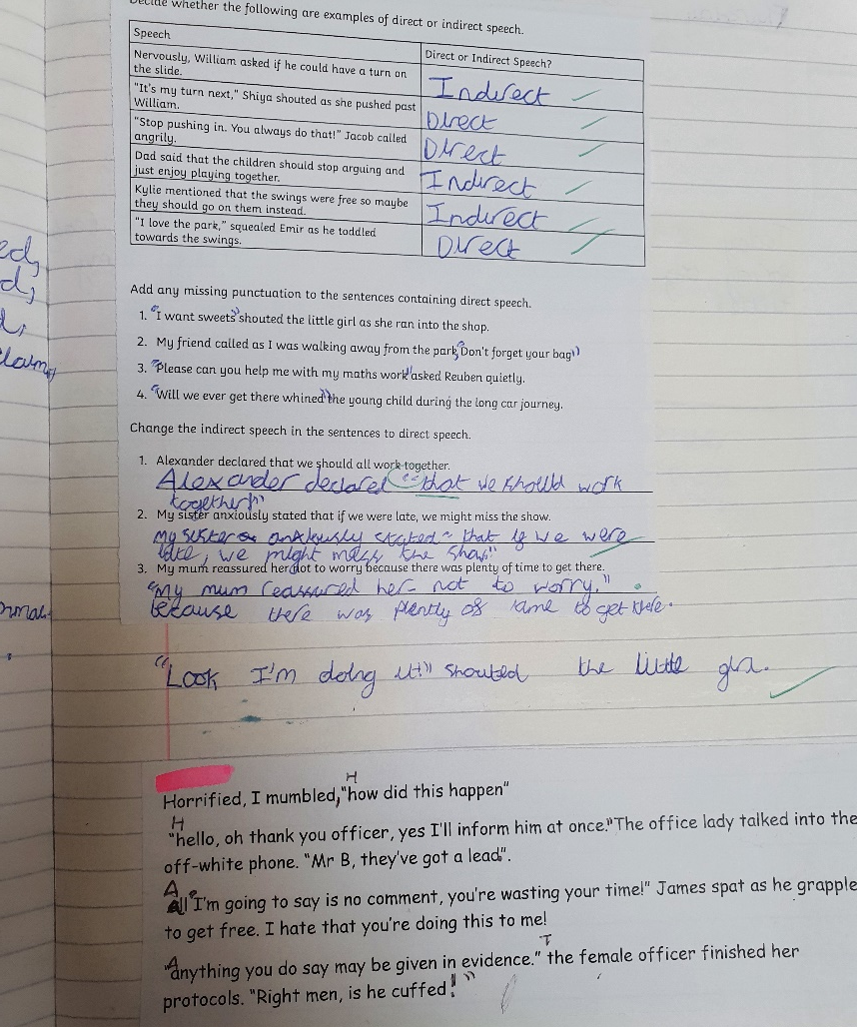
Redwood Wow Work

Slide 23
Next Week’s
Phrase of the Week:
Mistakes are the porthole to discovery!

