Slide 1
Wow Assembly:
Friday 15th October

Slide 2
Phrase of the Week:
Mistakes are proof you
are trying.

Slide 3
Green Cards!
Lexie – Ash
Alfie – Pine
Kade – Aspen
Kacper – Aspen
Liam – Chestnut
Bentley – Chestnut
Kara- Spruce

Slide 4
Scientists of the Week!
Oak –
Ash – Noah
Birch –
Pine – Willow
Elm – Finley
Willow –
Spruce –
Maple – Max
Redwood – Natalia
Chestnut – Wiki
Aspen- Alfie

Slide 5
Weekly Team Points!
Peel | Ethelfleda | Grazier | Offa
188 | 233 | 235 | 217

Slide 6
Oak
Madison
For
Taking lots of care when creating her Spring tree as part of our learning about the seasons.
Mrs Laffan 15.10.21

Slide 7
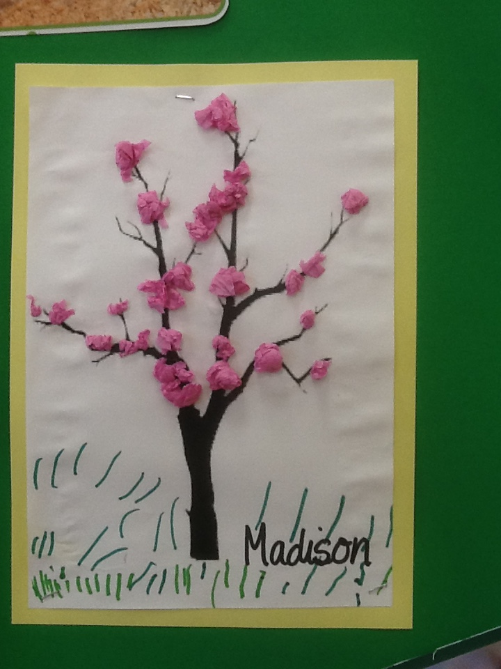
Oak Wow Work

Slide 8
Ash
Lexie
For amazing art work making a winter tree.
Miss Bailey and Mrs Salt 15.10.21

Slide 9
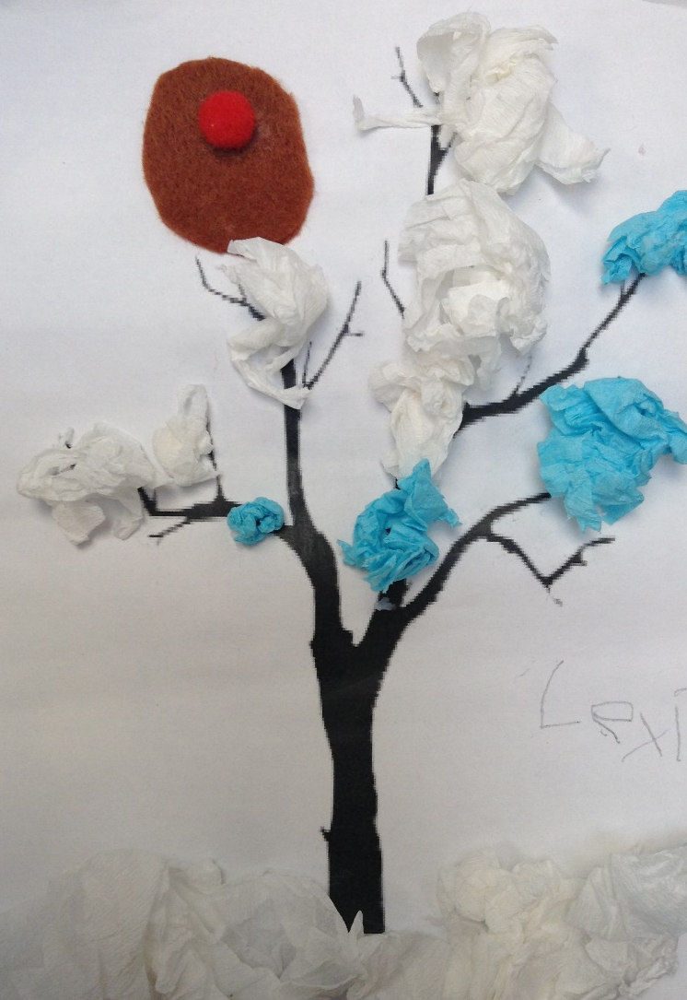
Ash Wow Work

Slide 10
Elm
Layla
For trying really hard in Maths! Layla has been completing addition sentences and is able to explain that the two numbers can be added either way around. Well Done!
Mr Grice 15.10.2021

Slide 11
Birch
For
The Whole class
For being resilient with the changes this week!
Miss Hewitt 10.09.21

Slide 12
Pine
Darcey
For using excellence in mathematics to solve addition sentences and find fact families. Well done!
Mrs Leedham-Hawkes 15.10.21

Slide 13
Maple
Ollie
For persevering to complete difficult tasks in maths using diennes and place value charts.
Well done Ollie
Miss Dawson 15.10.2021

Slide 14
Willow
Kacey
For her fantastic knowledge in Topic . Kacey has completed extra work at home and impressed the class with her knowledge about Martin Luther King. Well done Kacey.
Miss Fisher 15.10.2021

Slide 15
Spruce
Kara
For wonderful effort in all lessons, especially your diary entry about forest day. This writing shows how much
pride you take in your work, well done!
Mr Draper 15.10.21

Slide 16
Chestnut
Alfie
For
Showing a better working ethic and resilience during math lessons. He has worked well at being able to use a written method when dividing and having to deal with remainders. Well Done!
Mr Tennuci 15.10.21

Slide 17
Aspen
Lilly
For gaining confidence in herself during Maths. Lilly has understood column addition and subtraction really well and applied it to word problems! Well done Lilly ☺
Mrs Read & Mrs Cox 15.10.21

Slide 18
Redwood
Jack C
For trying to work independently in Maths. Jack has chosen the best resources and strategies to support his learning; working carefully through the problems
Miss Shipley 15.10.21

Slide 19
Cross Country
Huge Well Done to Tobias, Oliver, Jake, Alfie, Emma, Bella, Isla and Sophia for representing Woodlands at the cross country event yesterday. I am so proud of all of you and you should all be so proud of yourselves.
Miss Fisher 15.10.21

Slide 20
Next Week’s
Phrase of the Week:
Be the reason someone makes you smile

