Slide 1
Welcome to Aspen!
September
2020
Mrs Davies

Slide 2
Teacher Profile:
Mrs Davies
Welcome to Aspen
I am really looking forward to being your teacher next year! ☺
Facts about me
I am the Music coordinator at Woodlands
I am always singing- including grammar and Maths songs
I love shopping and animals
I am always talking about my black Labrador Louie

Slide 3
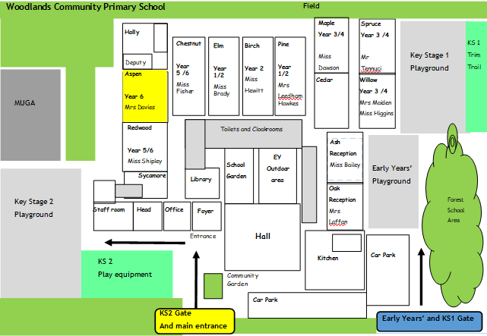
School Map
Your classroom is here!
Here is the map of our school site:

Slide 4
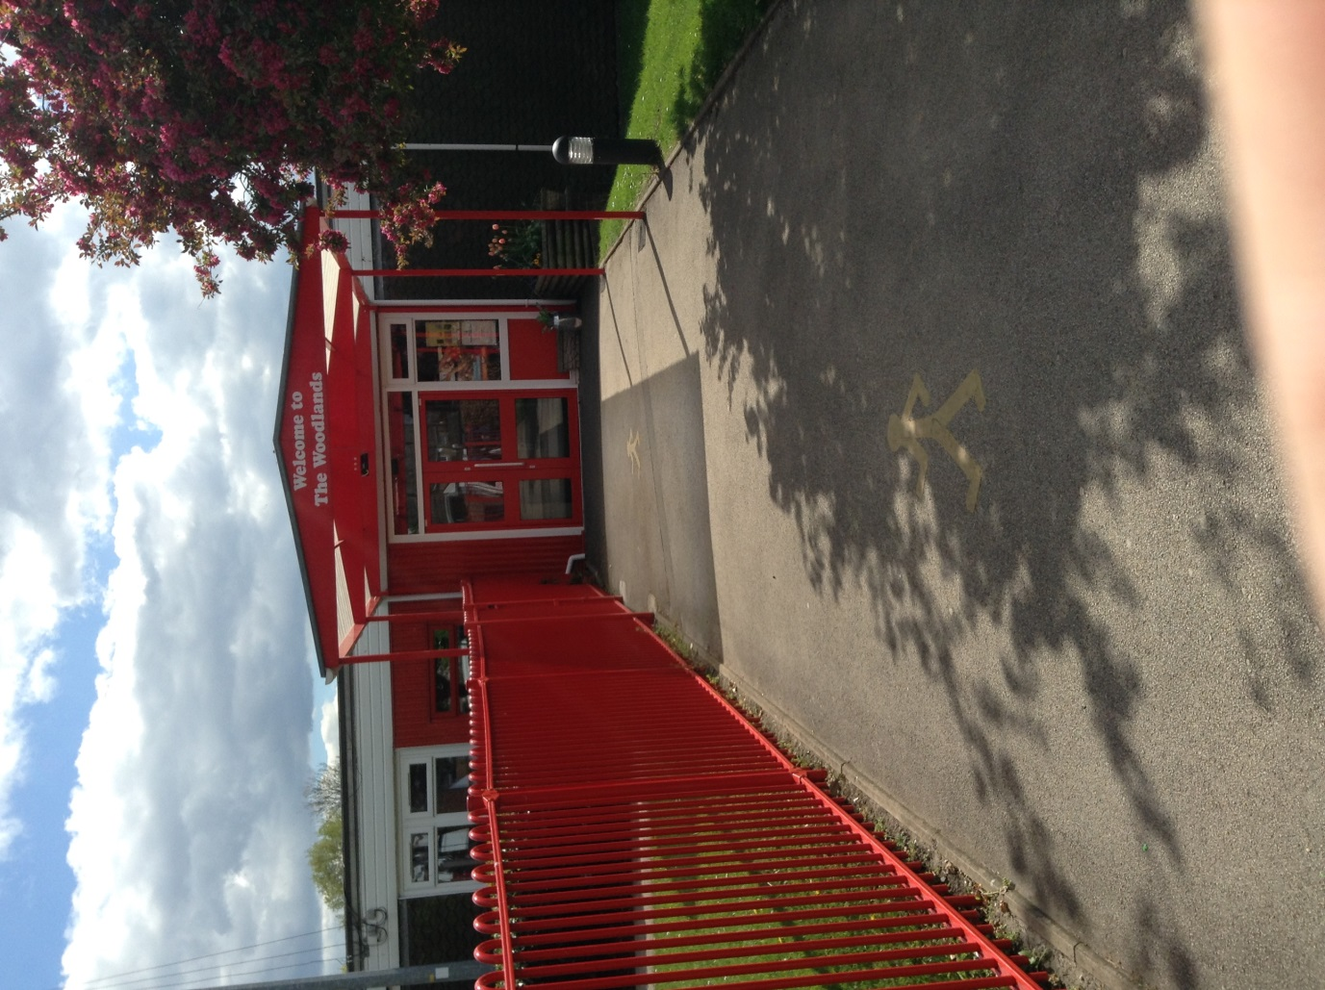
Welcome to Aspen!

Slide 5
Welcome to Aspen!

Slide 6
Welcome to Aspen!

Slide 7
Welcome to Aspen!

Slide 8
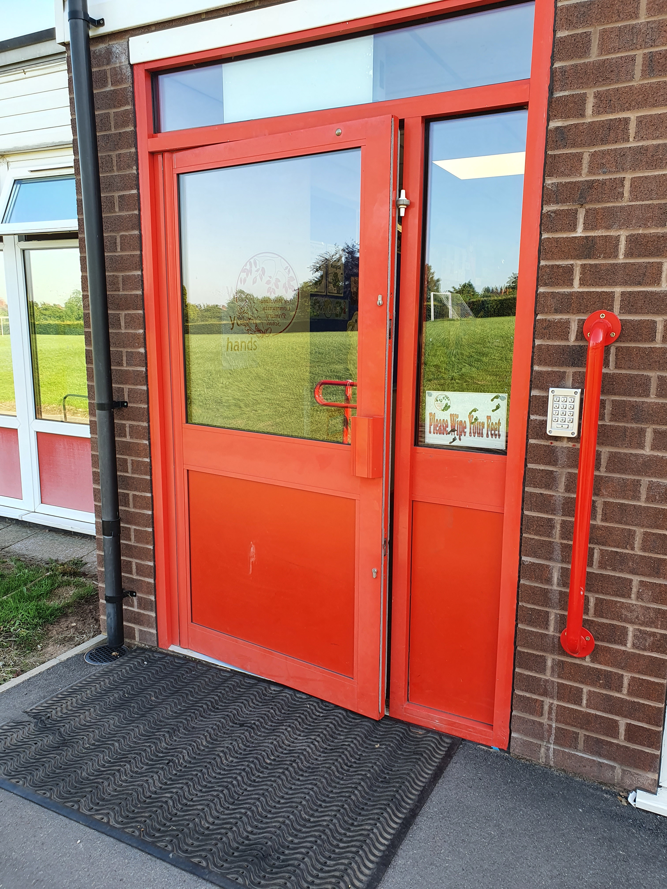
Welcome to Aspen!

Slide 9
Welcome to Aspen!
Come on in !

Slide 10
Play time!

Slide 11
Play time!

Slide 12
Play time!

Slide 13
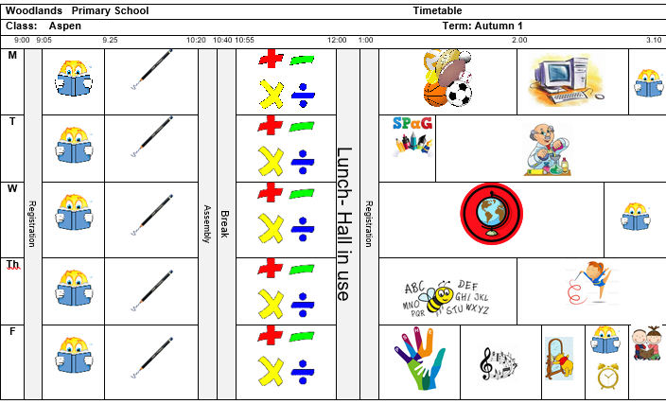
Timetable
Our timetable will look like this! We have Guided Reading, English and Maths every morning and our other subjects in the afternoons.

Slide 14
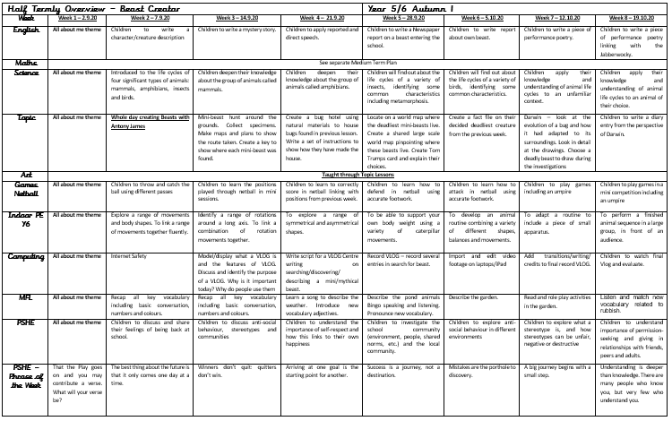
Learning Overview: Autumn 1
Here is an overview of what we will be learning during the first half term!

Slide 15
Houses:
Here are our school houses, named after important people from Tamworth’s history.
You will still be in the same house as last year – when you win team points, they all contribute to your team effort!
We will be voting for our new Year 6 House Leaders in September.

Slide 16
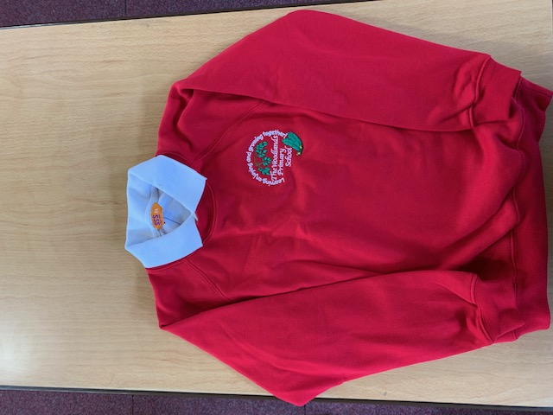
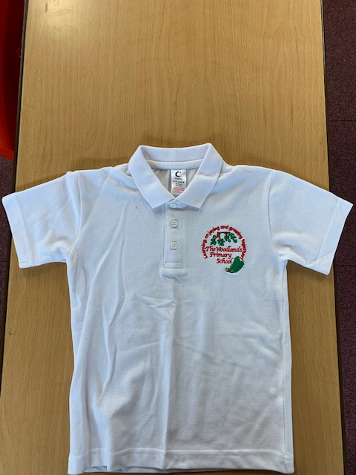
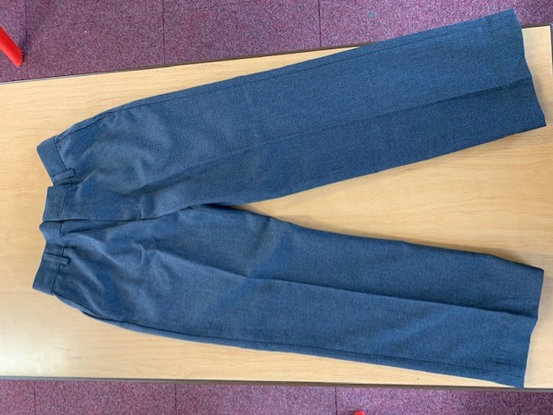
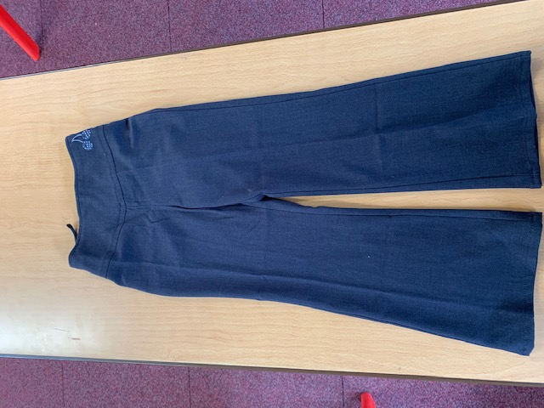
Uniform:
Please wear full school uniform every day.
Please make sure each item of uniform is clearly labelled with your name.
Please wear sensible school shoes – no trainers please.

Slide 17
PE Kit:
Please make sure you have your PE kit in school on the days you have PE.
Please make sure each item of kit is clearly labelled with your name.
Please don’t wear earrings on PE days.
If you have long hair, please tie it back on PE days.
Outdoor Kit
White T Shirt
Black jumper/tracksuit top. (No hood)
Black Tracksuit bottoms /Joggers.
Trainers
Indoor Kit
White T Shirt
Black/Navy shorts

Slide 18
Every day, please bring:
A water bottle with your name on
Your coat
Your reading book
Your reading diary
A school bag to hold all your belongings

Slide 19
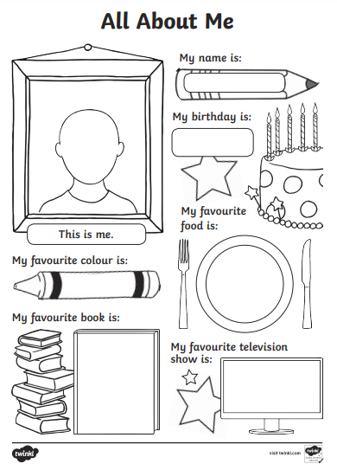
Please send us your ‘All About Me’ profiles !

Slide 20
Have a lovely summer and see you soon!
Mrs Davies

