Slide 1
Wow Assembly:
Friday 27th November

Slide 2
Phrase of the Week:
Worry is like a rocking horse: it passes the time but gets you nowhere.

Slide 3
Green Cards!
Jonah – Chestnut
Amelia M – Chestnut
Reilly – Redwood
Freya- Aspen
Eppie – Spruce
Malakai - Spruce

Slide 4
Scientists of the Week!
Oak –Noel
Ash – Adam
Birch – Lucy-Mae
Pine – Seb
Elm – Remey-Lei
Chestnut – Amelia M

Slide 5
Weekly Team Points!
Peel | Ethelfleda | Grazier | Offa
167
119
161
112

Slide 6
Oak
Franceseca
For
A fantastic letter to Santa.
Mrs Laffan 27 /11/20

Slide 7
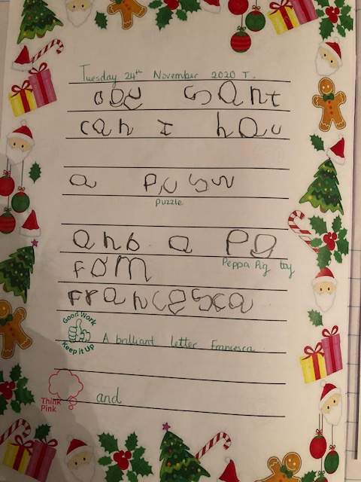
Oak Wow Work

Slide 8
Ash
Alaina
For exploring different ways to partition the number 8.
Miss Bailey 26/11/20

Slide 9
Ash Wow Work

Slide 10
Elm
Carla
For
Working hard in all lessons, showing resilience and being kind and helpful!
Miss Brady 27/11/20

Slide 11
Birch
Issac
For
Demonstrating excellent communication and teamwork skills during our Forest day. Issac is a fantastic listener and always shows kindness and empathy to all children! We are very lucky to have you in our class Issac!
Miss Hewitt 26 /11 /20

Slide 12
Pine
Vinny
For excellent communication and team work skills during Forest Day when completing the parachute activity. Vinny explained to others how to keep the ball from falling off the parachute. Well done ☺
Mrs Leedham-Hawkes 27 /11 /20

Slide 13
Maple
Charlie
For fantastic home learning.
Miss Dawson 27.11.2020

Slide 14
Maple Wow Work
Charlie is a superstar!
Charlie worked hard every day at home and completed all tasks set online.
Charlie has been able to transfer his knowledge from home learning into the classroom.

Slide 15
Willow
Liam
For an incredible effort all week to work hard, write confidently and challenge himself! Well done Liam – keep it up!
Mrs Maiden and Miss Higgins 27 /11 /20

Slide 16
Willow Wow Work
Liam worked really hard, listening well in every lesson!
Liam has worked confidently and enthusiastically in English all week – he writes so much independently now!
Liam used some super scientific vocabulary, explaining friction to the class.
Liam is always keen to read out the text from the board or give the instructions – his reading is becoming so fluent!

Slide 17
Spruce
Philippa
For
How well you have improved since joining our class and all the effort you show, especially in your reading and phonics.
Well done Philippa!
Mr Tennuci 27 /_11/20

Slide 18
Chestnut
Lily
For brilliant perseverance in Maths when calculating the perimeter of different shapes. Well done Lily.
Miss Fisher 27/11/20

Slide 19
Aspen
Amy
For superb passion and excellence in Maths focusing on squared and cubed numbers, common factors and prime numbers. Go girl!
Mrs Davies 27 /11 /20

Slide 20
Redwood
Jake C
For excellent empathy and resilience during Topic
Miss Shipley 27 /1 /20

Slide 21
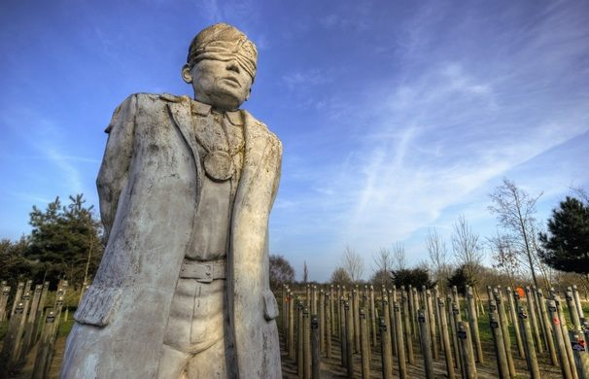
Redwood Wow Work
Jake worked incredibly hard and showed an amazing empathy with the soldier he was investigating.
Jake asked fantastic questions and used his investigation skills to the answers.
Amazing work Jake!

Slide 22
Next Week’s
Phrase of the Week:
What is popular is not always right; what is right is not always popular.

