Slide 1

Year 6 SATs presentation for families
2025/26

Slide 2

What are SATs?
SATs scores explained.
When SATs will take place.
Arrangements for your child.
What the papers look like.
Preparing children in school.
Expectations for home practice packs.
Common barriers the children face with assessments and daily learning.

Slide 3

What are SATs?
Statutory Assessment Tests
Firstly to see how well schools are performing and secondly to see how well children individually have learnt.
SATs are tests that test everything children have learnt throughout KS2. They begin with easier questions and gradually become more challenging.
Children may already have been exposed to some questions in previous year groups.
What we encourage …

Slide 4

What are the SATS tests?
SATS week across the country begins on Monday 11th May 2026.
The SATs papers are sat Monday to Thursday and consist of:
  Punctuation, Vocabulary and
  Spelling
  Reading Mathematics: 1 Arithmetic, Reasoning
Paper 2 and Reasoning Paper 3
Writing is assessed using evidence collected throughout
Year 6. There is no Year 6 SATs writing test.

Slide 5
The Timetable
We will advise when published.

Slide 6
Specific arrangements for SATs
Children with additional needs (who have similar support as part of day-to- day learning in school) may be allotted specific arrangements, including:
Additional (extra) time;
Tests being opened early to be modified;
Pre-ordered adapted papers
An adult to scribe (write) for them;
An adult to read for them;
The use of prompts or rest breaks;
Arrangements for children who are ill or injured at the time of the tests.
Pupils with an EHCP are automatically allowed up to 25% additional time (except for the spelling paper, which is not strictly timed). Pupils who use the modified large print or braille versions of the tests are automatically allowed up to 100% additional time.

Slide 7
How are the tests graded?
The marked tests will provide the following information:
A raw score (i.e. number of marks)
A scaled score
An indication of whether the national standard has been met.
On publication of the test results in July:
A child awarded a scaled score between 100 – 109, is judged to have met
the ‘national standard’ (ARE) (EXS) in the area judged by the test;
If a child’s score is between 110 or above, they are working beyond (or
above) the expected national standard (GDS).
If a child’s score is between 80 to 99, they are judged to have not yet met the national standard and performed below the expectation for their age (Working towards).

Slide 8
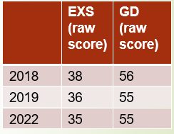
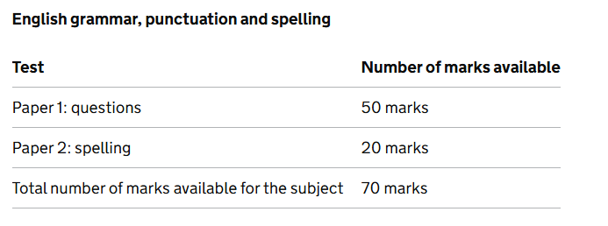
Spelling, Punctuation and Grammar: date 2026
There will be two papers to assess the child’s understanding of KS2 SPAG
Paper 1 focuses on all three elements (spelling, punctuation and grammar). The paper lasts for 45 minutes. Total marks available is 50.
Paper 2 consists of a spelling test only. It should take approximately 15 minutes, although this is not a set amount of time. Total marks available is 20.
 | EXS (raw score) | GD (raw score)
2018 | 38 | 56
2019 | 36 | 55
2022 | 35 | 55

Slide 9
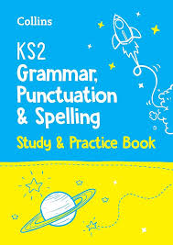
Spelling, Punctuation and Grammar: paper 1
The children will have been working hard with their class teacher on developing and securing their knowledge of the technical vocabulary needed in this test.
This test focuses on:
  Grammatical terms/ word classes;
  Functions of sentences;
  Combining words, phrases and clauses;
  Verb forms, tenses and consistency;
  Punctuation;
  Vocabulary;
  Standard English and formality.
This test requires a range of answers.

Slide 10

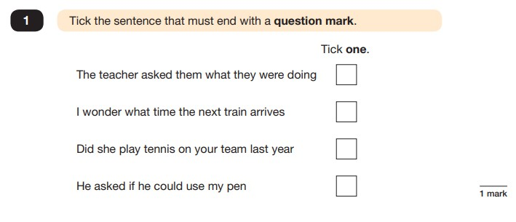

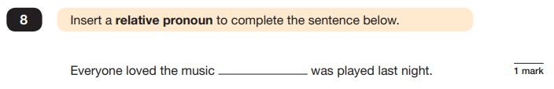

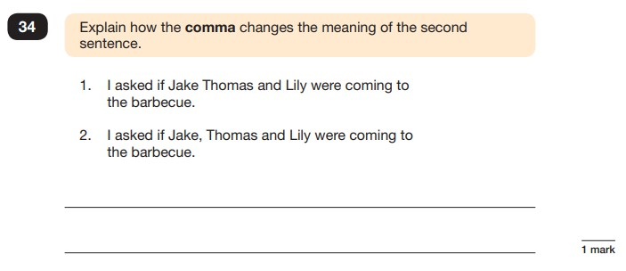
Spelling, Punctuation and Grammar: Paper 1
Example questions:
e.g. that, which

Slide 11
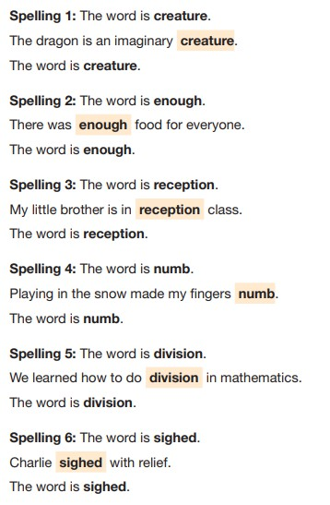
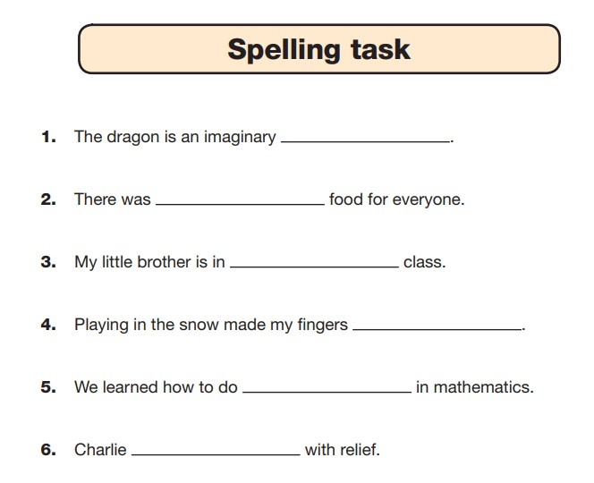
Spelling, Punctuation and Grammar: Paper 2

Slide 12
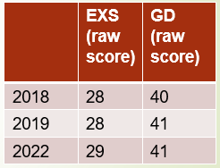
Reading: Dates to be confirmed for 2026
The reading test consists of a single test paper with three unrelated reading texts from a selection of genres. These could be any combination of non-fiction, fiction and/ or poetry.
The test is designed to measure if the children’s comprehension of age- appropriate reading material meets the national standard.
Children are given 60 minutes in total, which includes reading the texts and answering the questions.
A total of 50 marks are available
 | EXS (raw score) | GD (raw score)
2018 | 28 | 40
2019 | 28 | 41
2022 | 29 | 41

Slide 13

  The children will be given three texts and be asked to answer a range of questions on each. The texts in the test booklets are completely unrelated.

Slide 14

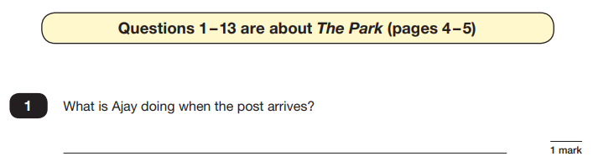

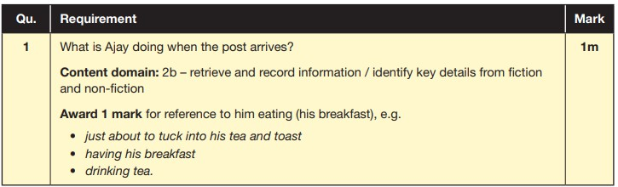
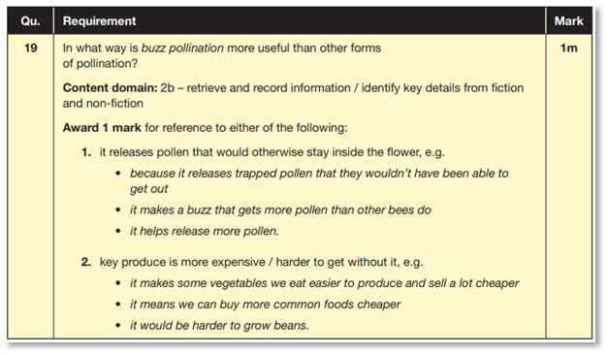
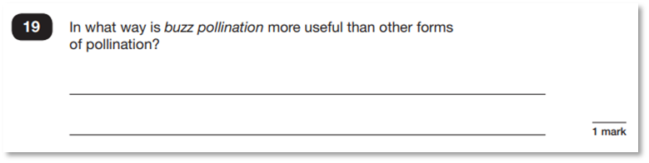
Reading
The reading SATs paper requires a range of answer styles. Example questions:

Slide 15
How to Help Your Child with Reading
Listening to your child read can take many forms.
First and foremost, focus developing an enjoyment and love of reading.
Enjoy stories together – reading stories to your child at KS1 and KS2 is equally as important as listening to your child read.
Read a little at a time but often, rather than rarely but for long periods of time!
Talk about the story before, during and afterwards – discuss the plot, the characters, their feelings and actions, how it makes you feel, predict what will happen and encourage your child to have their own opinions.
Look up definitions of words together – you could use a dictionary, the Internet or an app on a phone or tablet.
All reading is valuable – it doesn’t have to be just stories. Reading can involve anything: fiction, non-fiction, poetry, newspapers, magazines, football programmes and TV guides.
Home reading, school library book, Lexia and practice work will be sent home weekly.

Slide 16
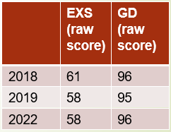
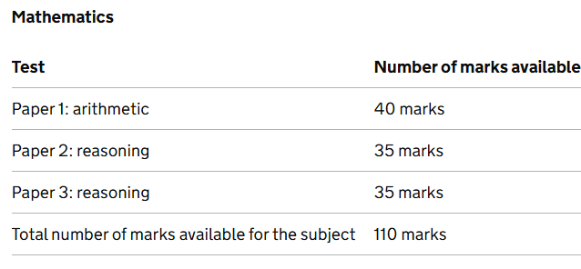
Maths: 2026 dates
The maths assessments consist of three tests.
Paper 1: Arithmetic (30 minutes)
Paper 2: Reasoning (40 minutes)
Paper 3: Reasoning (40 minutes)
 | EXS (raw score) | GD (raw score)
2018 | 61 | 96
2019 | 58 | 95
2022 | 58 | 96

Slide 17

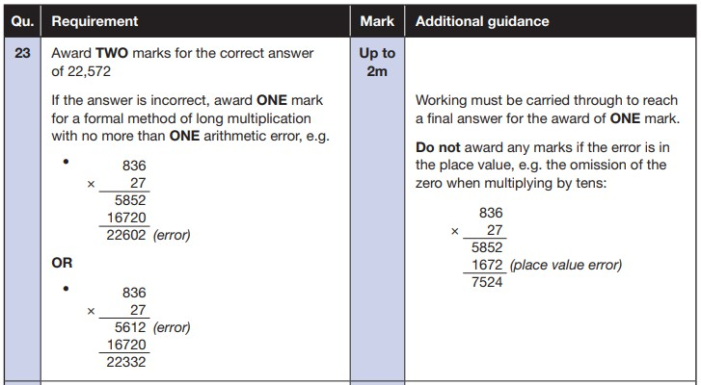

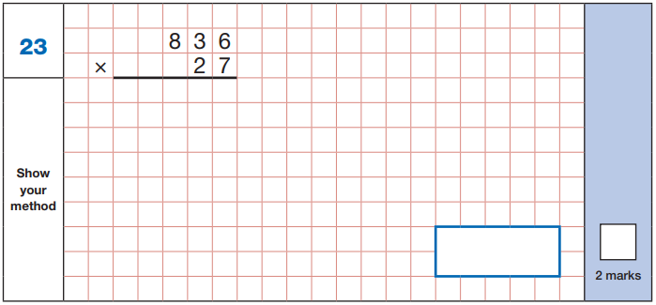
Maths Paper 1 (Arithmetic)
The maths arithmetic has a total of 40 marks. Pupils will have 30
minutes to complete the paper.
The test covers the four operations (addition, subtraction, multiplication, division, including order of operations requiring BIDMAS), percentages of amounts and calculating with decimals and fractions.
Example question:

Slide 18

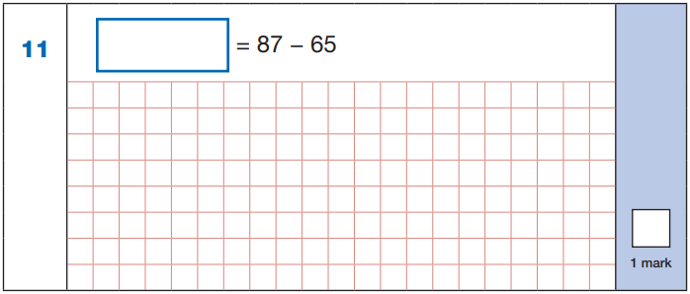

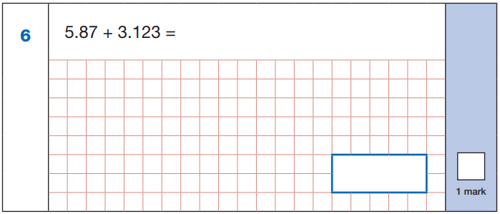
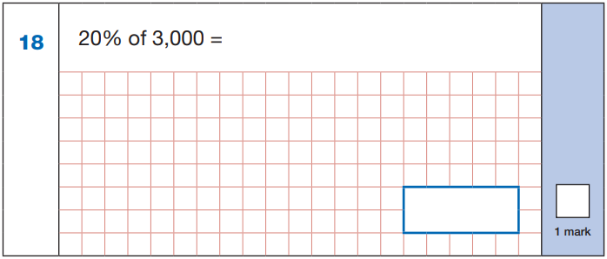

22
Maths Paper 1 (Arithmetic)
Example questions:
87
- 65
22
5.87
+ 3.123
8.993
8.993
10% of 3,000 = 300
20% of 3,000 = 600
60 ÷ (30 - 24)
60 ÷ 6 = 10
600
10

Slide 19
Maths Papers 2 and 3 (Reasoning)
Paper 2 and paper 3 have a total of 35 marks each. Each paper will last for 40 minutes.
These papers require children to demonstrate their mathematical knowledge and skills, as well as their ability to solve problems and their mathematical reasoning. They cover a wide range of mathematical topics from key stage 2 including,
Number and place value (including Roman numerals);
The four operations;
Geometry (properties of shape, position and direction);
Statistics;
Measurement (length, perimeter, mass, volume, time, money);
Algebra;
Ratio and proportion;
Fractions, decimals and percentages.

Slide 20


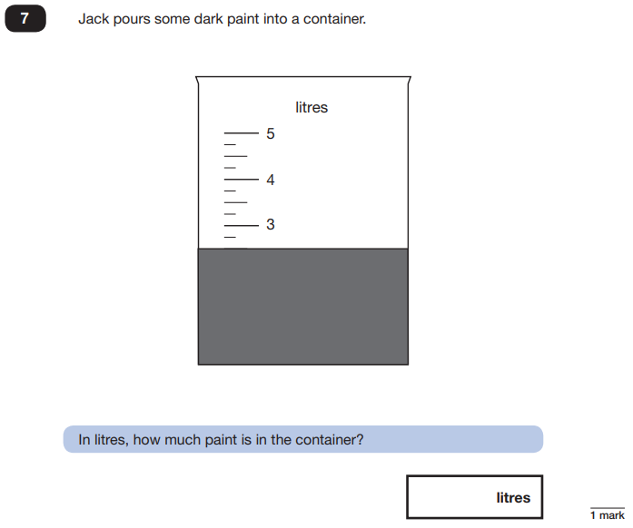
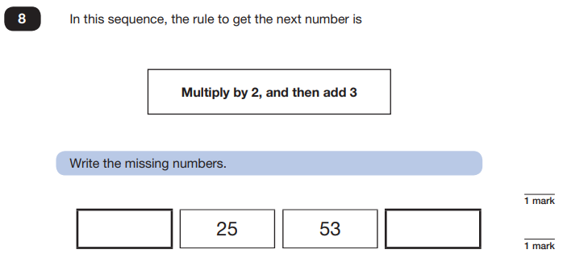
Maths Papers 2 (Reasoning)
Example questions:
11
109
2.5 or 2 ½

Slide 21

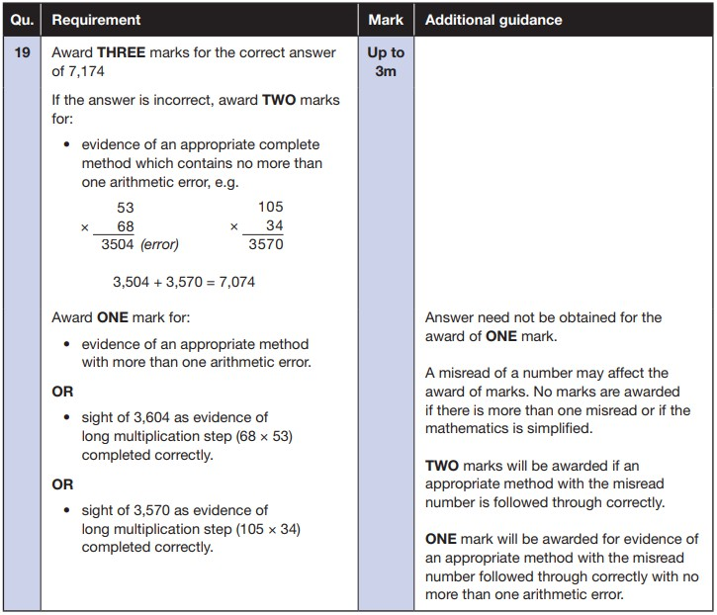

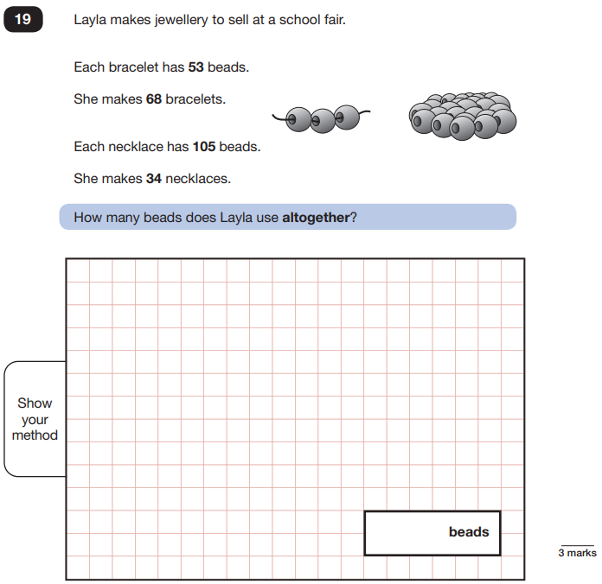
Maths Papers 3 (Reasoning)
Example question:

Slide 22
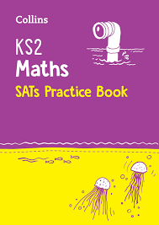
How to Help Your Child with Maths
  Play times tables games.
  Play mental maths games including counting in different amounts, forwards and backwards.
  Encourage opportunities for telling the time.
  Encourage opportunities for counting coins and money; finding amounts or calculating change when shopping. Money is good for decimals too!
  Read longer numbers, e.g. house prices!
  Look for examples of 2D and 3D shapes around the home.
  Identify, weigh or measure quantities and amounts, e.g. when cooking.
  Play games involving numbers or logic, such as dominoes, card games, monopoly etc.
  Notice and talk about percentages and fractions, i.e. money off etc.

Slide 23
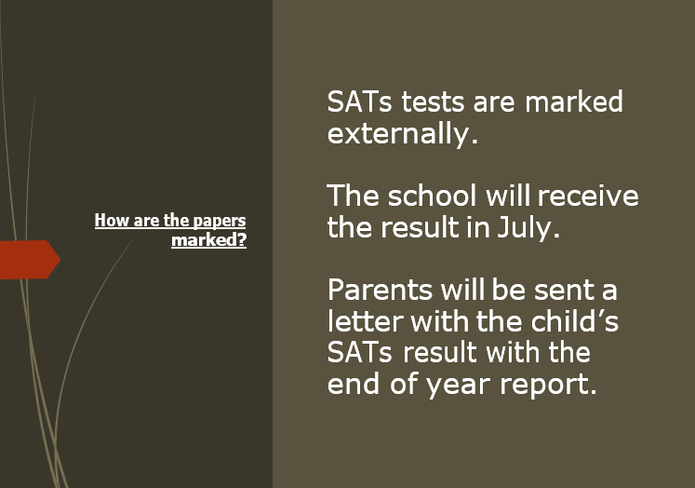

Slide 24
Writing Assessments
There is no writing SATS test.
Writing assessments will be formed from judgements made by the teacher, looking at evidence from writing collected over the course of the year.
The teacher will moderate their assessments with other
professionals to make sure there is a consistent standard across the country.
Final judgements will be reported to parents at the
same time as the other assessment results.

Slide 25
How to Help Your Child with Writing
  practice and learn weekly spellings – make it fun!
  Encourage opportunities for writing such as letters to family or friends, shopping lists, notes or reminders, stories and poems.
  Drawing and artwork is good for stamina and pen control.
  Write together – be a good role model for writing.
  Encourage use of a dictionary to check spelling and a thesaurus to find
synonyms and expand vocabulary.
  Allow your child to use a computer for word processing, which will allow for editing and correcting of errors without lots of crossing out.
  Remember that good readers become good writers! Identify good writing features when reading (e.g. vocabulary, sentence structure and punctuation).
  Show your appreciation: praise and encourage, even for small successes!

Slide 26
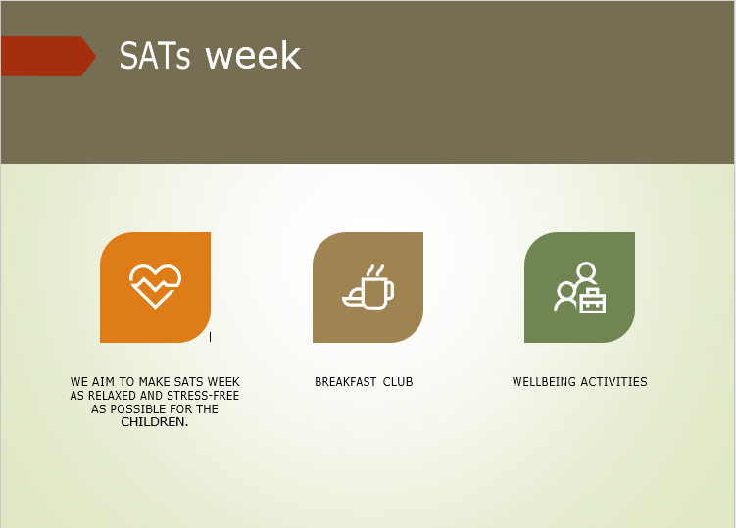

Slide 27

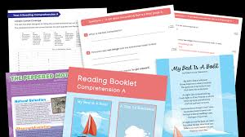
Supporting your child in preparing for the SATs
Firstly, a positive attitude goes a long way. Give them as much encouragement and support as you can (but we don’t need to tell you that)!
First and foremost support and reassure your child that there is nothing to worry about and they should always just try their best.
Praise and encourage them.
Ensure your child has the best possible attendance at school and to all boosters.
Support your child with any practice tasks, especially with learning their spellings.

Slide 28
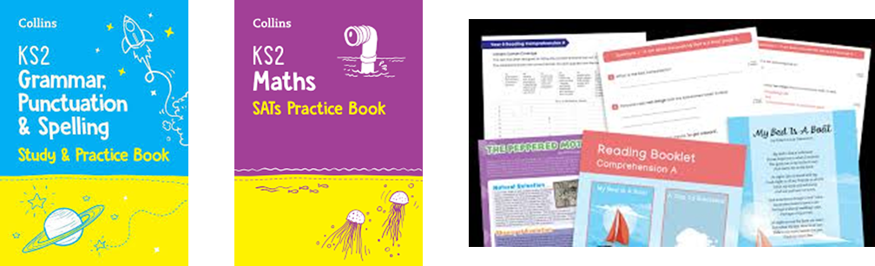
Home Practice Packs
Practice Packs of 2 reference books and 2 workbooks can be provided to every Y6 child at the cost of £5 payable on ParentPay which is heavily subsidised by school.
Reference books will be loaned to each child and returned to school after SATs.
Workbooks will be theirs to keep and write in.
£5 will be refunded on ParentPay after SATs after confirmation that practice tasks have been completed and children have attended Boosters Groups as invited.

Slide 29

Practice activities are to be completed at home (please discuss with class teacher any particular arrangement required for your child).
Every Monday 1 piece of practice work will be set (a rotation of maths, reading, SPAG) this will be reviewed at Christmas.
Children will record this in their Practice Diary.
All workbooks and Practice Diary will be handed in each Friday for teachers to review in class.
Practice Packs will be issued just before October half term and weekly tasks set thereafter.

Slide 30
Supporting your child in preparing for the SATs
Spend time with your child to complete the SATs home practice and ensure that they bring it to school every day (Team Points).
Encourage your child to talk to their teacher or a trusted
adult (including yourself) about any anxieties.
Give your child time to go outside and reduce screen time.
Ensure your child is eating and drinking well and getting a good amount of sleep.
Plan something nice and fun for the weekends before and
after SATs. This will help them to relax before the SATs
and give them something to look forward to after.

Slide 31
In School
  We will continue to teach your child daily in smaller sized classes.
  We will offer before or after school booster sessions for specific pupils.
  We will provide readers / prompters for the tests as necessary for specific pupils.
  We will provide sample questions daily for pupils to practice.
  We will send home SATs practice activities each week.
  We will provide time in school to follow up homework booklets and support with any areas needed.
  We have already given the children experience of the SATs in mock weeks which helps to normalise these tests.

Slide 32

🠶Most importantly, the wellbeing of your children is our priority!
🠶It is really important that the children feel calm and relaxed about their SATs. All we want to see is children to do their best and they will not do their best if they are feeling worried.

Slide 33
What to do if you are worried about your child
Talk to the school
Sometimes concerns present at home and not at school. If you notice a change in your child, talk to the school so that everyone concerned can offer the support needed.
Talk to your child
Talk to your child about what aspect of SATs concerns them the most. If you can help them pinpoint what is bothering them the most, you can take specific steps to help reassure them.
Encourage your child to talk to their teacher
SATs are obviously linked to school. Don’t be surprised if your child
would prefer seek reassurance from teachers over family members.
Try not to project your own anxieties or views about the SATs Children can be very intuitive. If they see that you are anxious, this could add to their own anxieties.

Slide 34



