Slide 1



Wow Assembly:
Friday 26th June

Slide 2
Phrase of the Week:
A recipe burned is a lesson learned.

Slide 3
Green Cards!
Ash – Remey-Lei
Ash - Veer
Maple – Charley
Aspen- Lila

Slide 4
Scientists of the Week!
Oak –Felicity
Ash – Darci
Cedar - Nina
Willow –
Spruce –
Birch – Ollie
Pine – Harri E
Elm -
Redwood – Saahil
Chestnut – Irwin
Aspen- Lila

Slide 5
Weekly Team Points!
Peel | Ethelfleda | Grazier | Offa
99
99
150
103

Slide 6
Oak
Freddie
For
Super attitude to learning and fantastic independent writing. He has written simple descriptions using his phonic knowledge about characters from Nemo. Well done Freddie ☺
Mrs Laffan 26.06.20

Slide 7
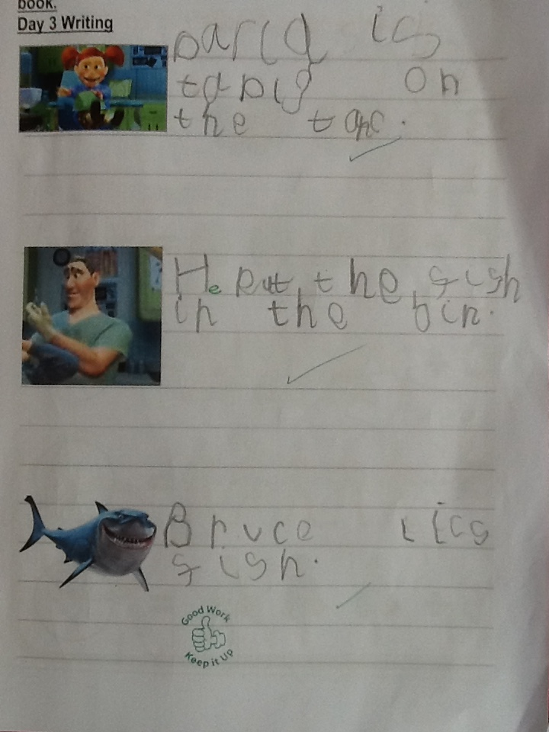
Oak Wow Work

Slide 8
Ash
Ronnie
For hearing initial sounds independently and trying hard to write them.
Well done Ronnie!
Miss Bailey 26.06.20

Slide 9
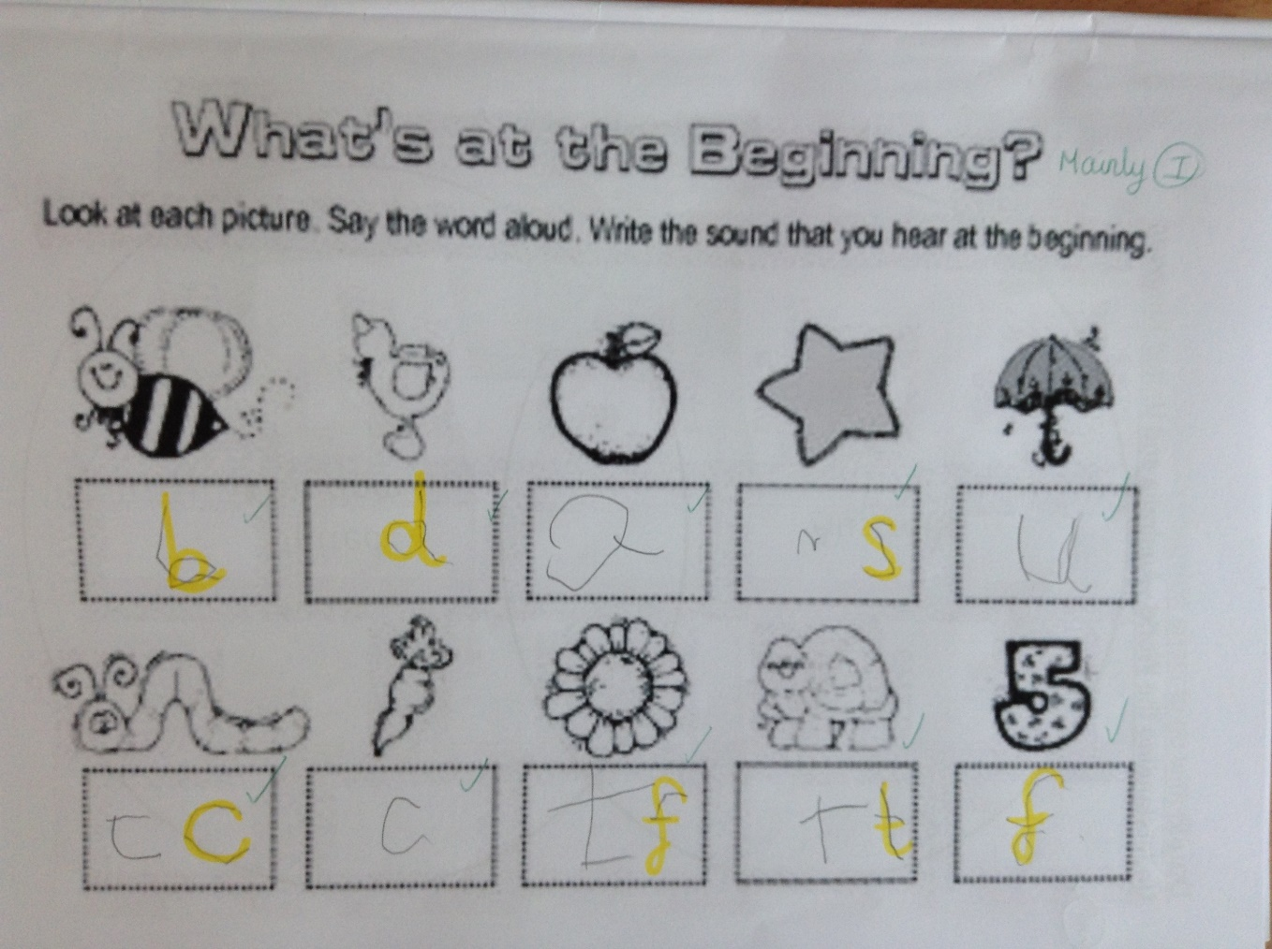
Ash Wow Work

Slide 10
Cedar
Lucas
For super independent phonics work.
Well done Lucas!
Mrs Scott 26.06.20

Slide 11
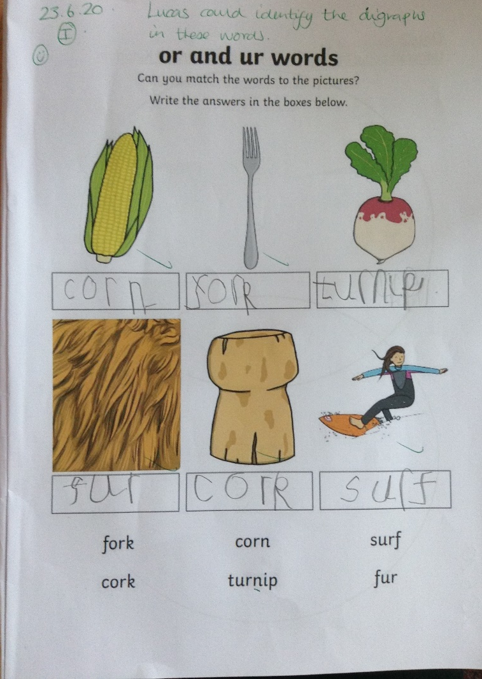
Cedar Wow Work

Slide 12
Pine
Kai E, Kody T, Ruby A and
Harri E
For returning to school this week with fantastic attitudes and huge smiles. We have missed you and so glad to see you back in Pine.
Mrs Leedham-Hawkes 12.06.20

Slide 13
Elm
Nevaeh, Mikey, Betsy and Ellie
For a fantastic return to school and trying so hard. We have missed you so much! It’s good to have you back
Miss Brady 12.06.20

Slide 14
Birch
Sid
For making excellent links in maths and applying his learning to solve more complex problems. Well done Sid!
Miss Hewitt 26.06.20

Slide 15
Chestnut
Ned
For showing excellence and perseverance in Maths.
Miss Fisher 26.06.20

Slide 16
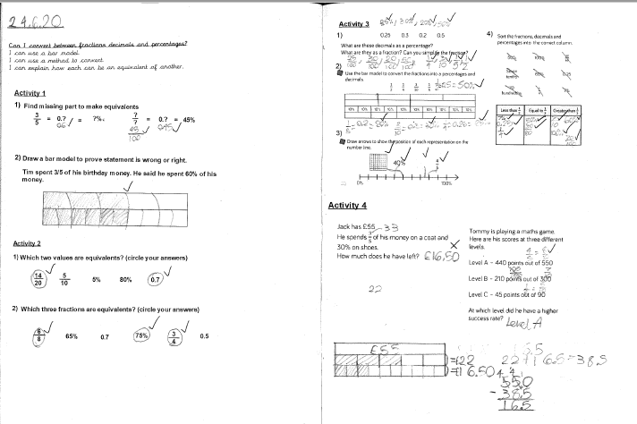
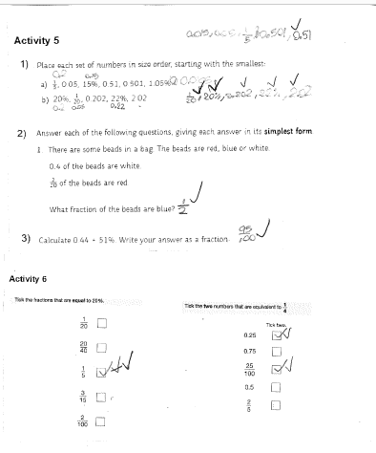
Chestnut Wow Work

Slide 17
Willow
Isabella
For her amazing MATHS work.
First week back at school and you're smashing it!!
Well done Izzy!!
Miss Higgins 26.06.20

Slide 18
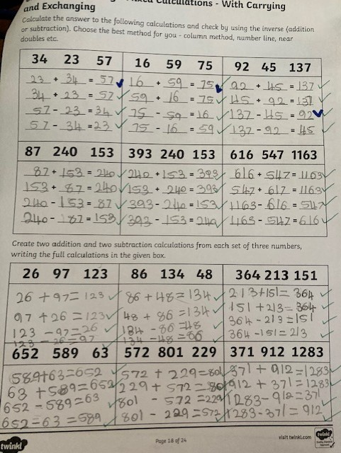
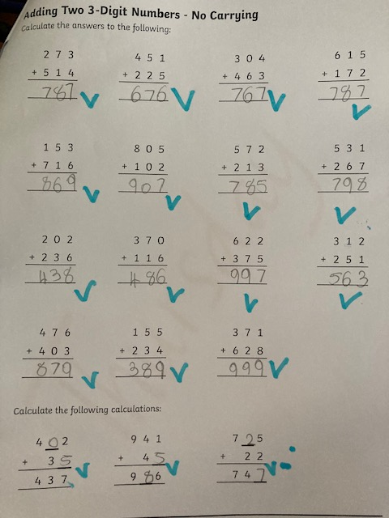

Slide 19
Spruce
Oscar W.
For
Independently writing a list poem about happiness.
Miss Dawson 12.06.2020

Slide 20
Spruce WOW Work

Slide 21
Aspen:
Liam
For superb perseverance in Maths.
Liam has shown great resilience and perseverance in Maths, especially with finding fractions of amounts. Keep it up!
Mrs Davies 12.06.20

Slide 22
Redwood
Rebecca
For
Fantastic use of materials and skills to produce her own Tudor Rose from sketching and using crepe paper.
Mr Tennuci 12.06.20

Slide 23
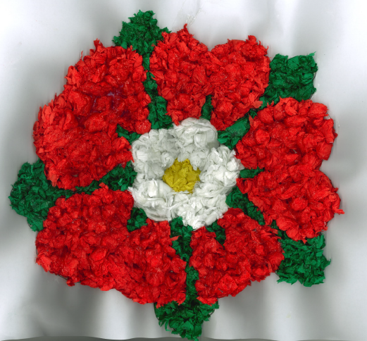

Slide 24
Phrase of the Week:
Although a ship is safe in the harbour, that’s not what it was built for.

