Slide 1
Wow Assembly:
Friday 29th April

Slide 2
Phrase of the Week:
Life isn’t about waiting for the storm to pass, it’s about learning to dance in the rain.

Slide 3
Green Cards!
Jaxon – Ash
Mollie – Ash
Noah – Ash
Matthew – Ash
Travis – Ash
Parker - Ash
Leah-Oak

Slide 4
Scientists of the Week!
Oak –Maisie
Ash – Parker
Birch – Robyn
Pine – Vinny
Elm – Ronnie
Willow – Evie
Spruce –
Maple – Dexter
Redwood – Ruby C
Chestnut –
Aspen - Kacper

Slide 5
Weekly Team Points!
Peel | Ethelfleda | Grazier | Offa
64 | 52 | 74 | 68

Slide 6
Oak
Madison
For
Writing her Easter holiday news independently.
Mrs Laffan 29.4.22

Slide 7
Ash
Harry
For super independent writing.
Miss Bailey and Mrs Salt 29.04.22

Slide 8
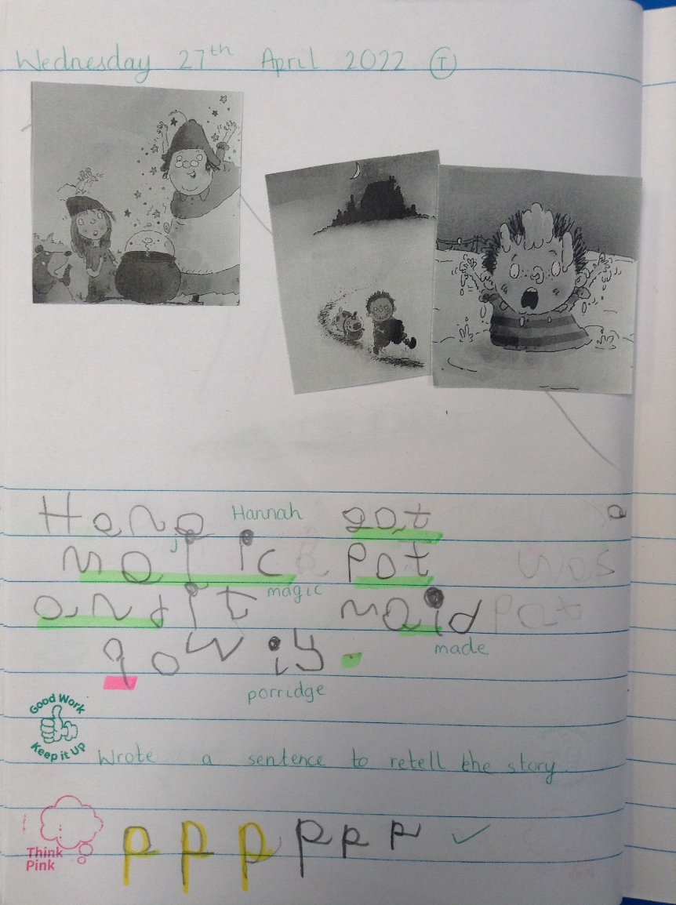
Ash Wow Work

Slide 9
Elm
Alaina
for being so enthusiastic within our hook day, creating many different shapes with her hands to carry the water for our Commando Jo mission – Great Resilience, Well Done Alaina☺
Mr Grice 29.04.2022

Slide 10
Birch
Eli
For
Eli has came back to school with a super attitude to learning! He has written a fantastic recount about our hook day!
Miss Hewitt 29.04.22

Slide 11
Pine
Willow
For using empathy to help a friend at playtime who fell over. Such kindness ☺
Mrs Leedham-Hawkes 29.04.22

Slide 12
Maple
Harri E.
For trying extremely hard to improve his
handwriting. Keep it up Harri!
Miss Dawson 29.04.2021

Slide 13
Willow
Oliver
For showing excellence in Computing and sharing your knowledge of Excel with the class.
Miss Fisher 28.04.22

Slide 14
Spruce
Cody
For showing excellence in his maths work.
Miss Volante 10.09.21

Slide 15
Chestnut
Amira
For her brilliant inspirational speech she has written this week. She has also continued to act upon advice given, to improve on what she has already written.
Mr Tennuci 29.4.22

Slide 16
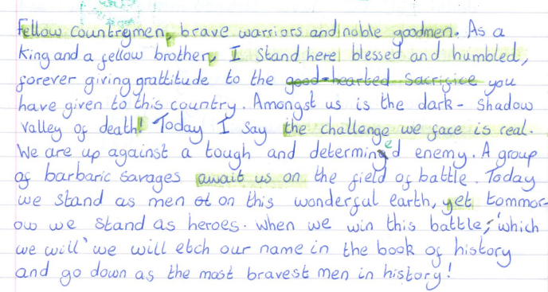
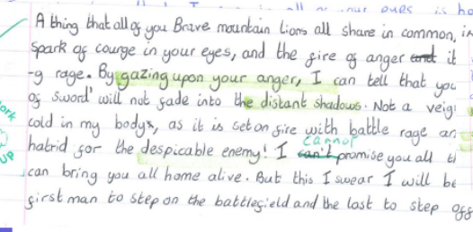
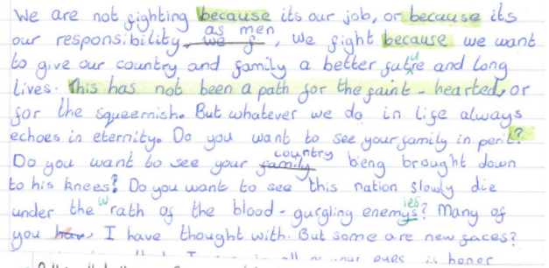
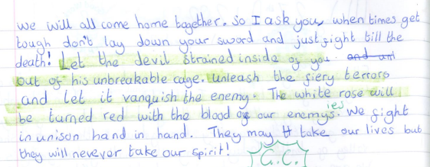
Chestnut Wow Work

Slide 17
Aspen
Oliver
for great retrieval
skills used during History.
Miss Bennett& Mrs Read 29.04.2022

Slide 18
Redwood
Natalia R
For demonstrating an amazing attitude towards her learning in all lessons. Keep up the fabulous work and perseverance!
Miss Shipley 29.04.22

Slide 19
Next Week’s
Phrase of the Week:
"Do more than belong: participate. Do more than care: help. Do more than believe: practice."

