Slide 1



Wow Assembly:
Friday 16th October

Slide 2
Phrase of the Week:
A big journey begins with a small step!

Slide 3
Green Cards!
Lucy-Mae– Birch
Kade - Maple
Molly – Redwood
Grace - Redwood

Slide 4
Scientists of the Week!
Birch – Oliver J
Pine – Darci
Elm – Brooke H
Willow – Riley WP
Maple – Charlie
Redwood – Tianna
Chestnut - Ray
Aspen-

Slide 5
Weekly Team Points!
Peel | Ethelfleda | Grazier | Offa
317
324
256
253

Slide 6
Elm
Tobias Y
For
A super effort and resilience shown in maths. Tobias has worked hard to use objects to subtract numbers.
Miss Brady 16.10.20

Slide 7
Birch
For
Tyler
Tyler has really impressed me in maths this week. He can confidently count in tens from any given number. He can find ten less and ten more of a number and has challenged himself to solve more complex problems involving place value. Well done Tyler!
Miss Hewitt 16.10.20

Slide 8
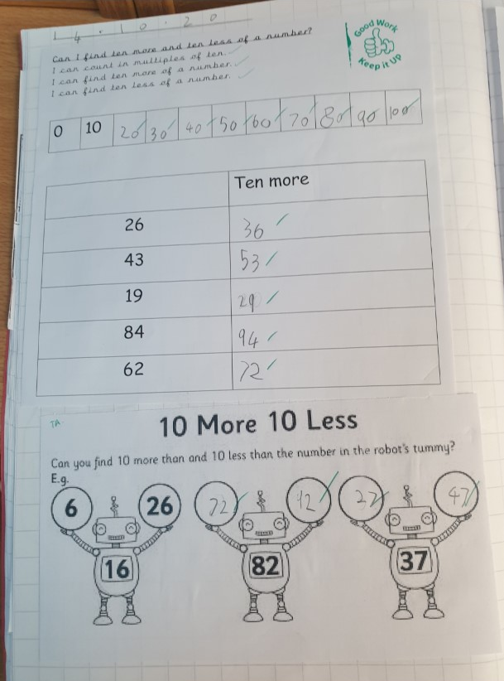
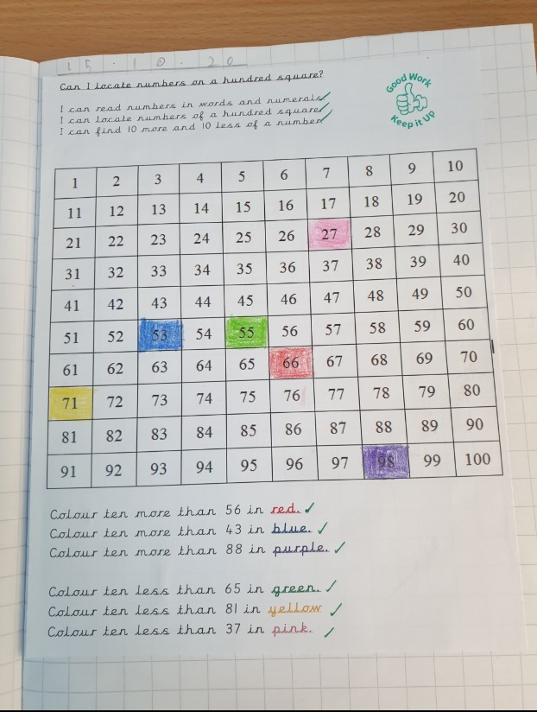
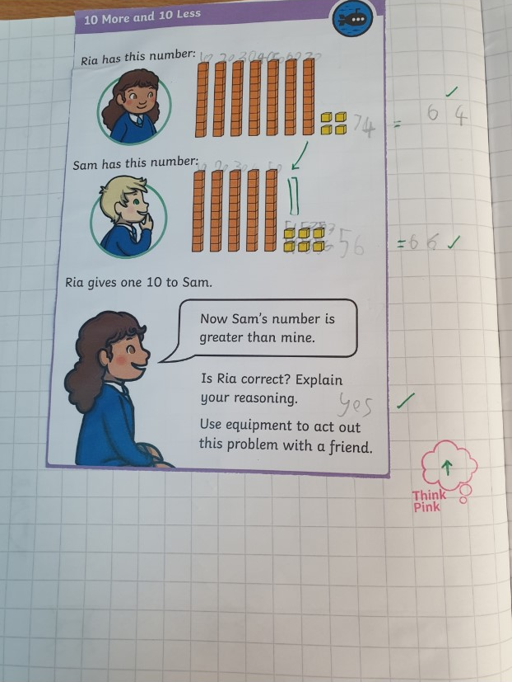
Birch Wow Work

Slide 9
Pine
Isabella
For using passion and excellence to create a Starry Night cityscape in the style of Van Gogh. Well done! ☺
Mrs Leedham-Hawkes 16.10.20

Slide 10
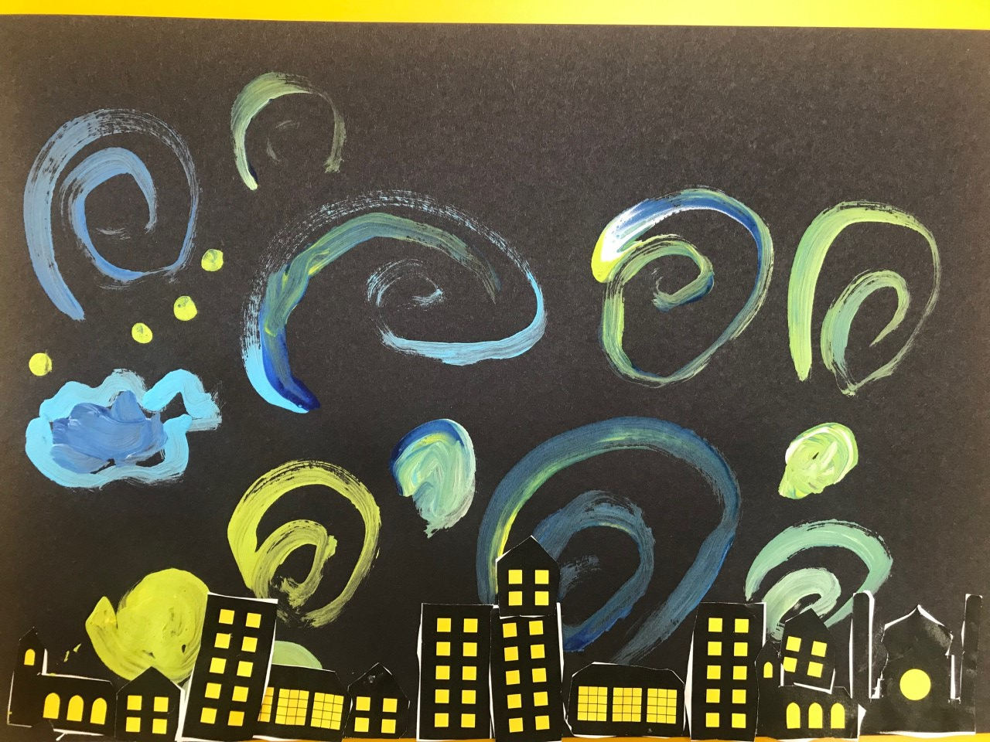
Pine Wow Work

Slide 11
Maple
Annalia
For always working to the best of her ability. Concentrating at all times and listening carefully to apply new learning into independent work.
Miss Dawson 16.10.20

Slide 12
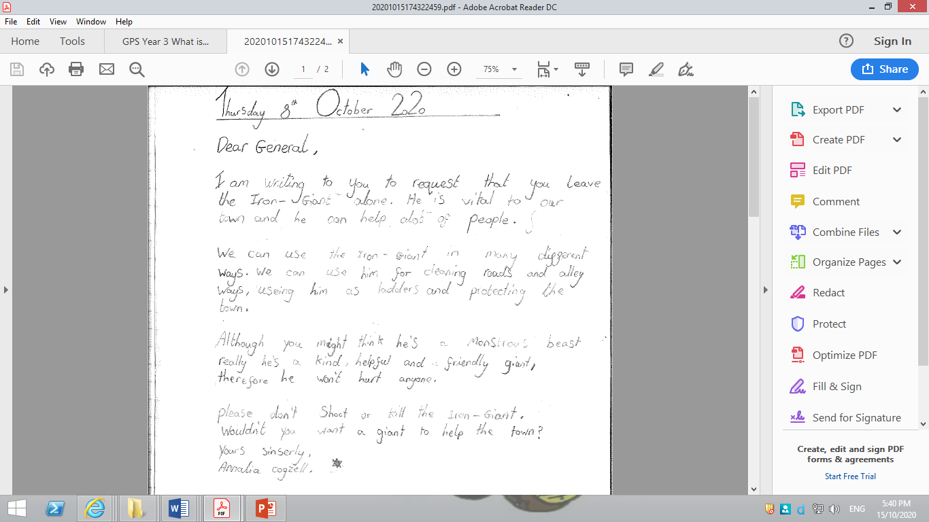
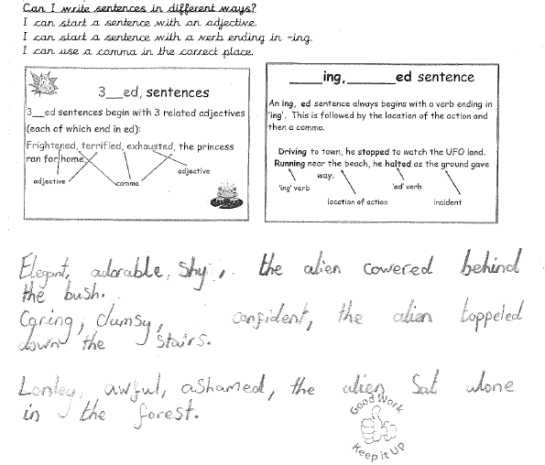
Maple Wow Work

Slide 13
Willow
Lilly
For her amazing all round learning this week at home and school.
Mrs Maiden and Miss Higgins 16.10.20

Slide 14
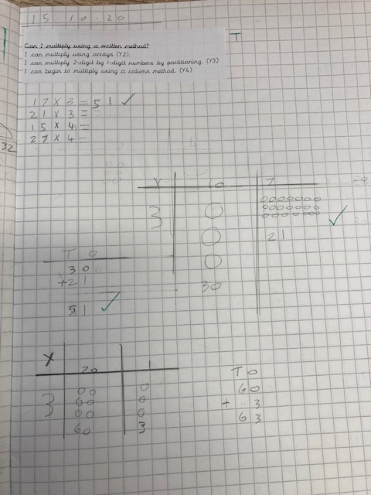
Willow Wow Work
Here’s an example of Lilly’s wonderful maths work. She has shown such a good understanding of multiplication this week ☺
She has also been doing lots of writing at home related to our Mighty Metals topic which has been lovely to read!
Well Done Lills, keep up the hard work!

Slide 15
Spruce
Alyssa
For
Showing a change in attitude towards her maths this week!
Well done! Keep this up.
Mr Tennuci 16.10.20

Slide 16
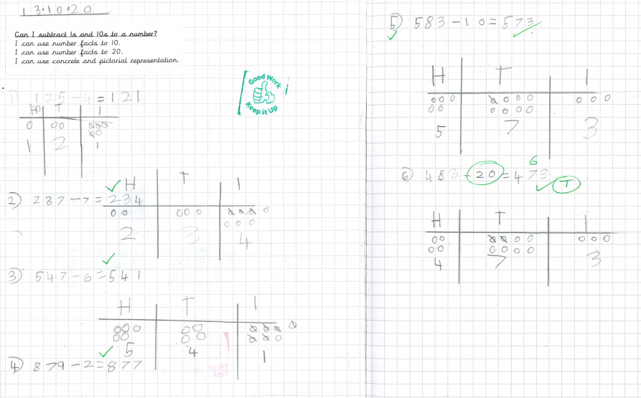
Spruce Wow Work

Slide 17
Chestnut
Mimi
For fantastic work doubling and halving numbers in maths. You were able to apply different strategies to help you work out the correct answers.
Miss Fisher 16.10.20

Slide 18
Aspen
Wilson
For showing excellence when completing multiplication work.
Mrs Davies 16.10.20

Slide 19
Aspen Wow Work
Wilson has absolutely excelled in multiplication learning this week. He’s been able to rapidly recall facts and explain how to multiply by 10, 100 and 1000.
Keep it up!

Slide 20
Redwood
Wiki
For demonstrating amazing skills and self-awareness during art
Miss Shipley 16.10.20

Slide 21
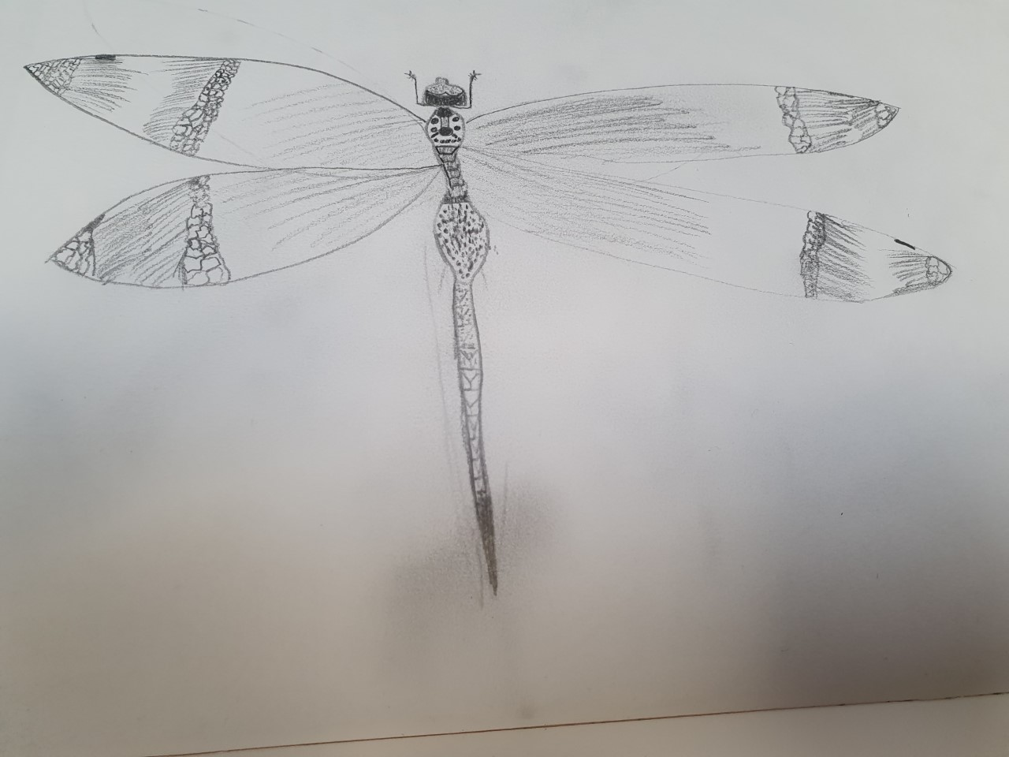
Redwood Wow Work

Slide 22
Next Week’s
Phrase of the Week:
Understanding is deeper than knowledge; there are many who know you but few who understand you.

Slide 23


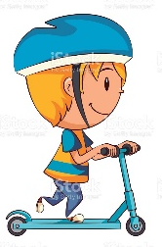


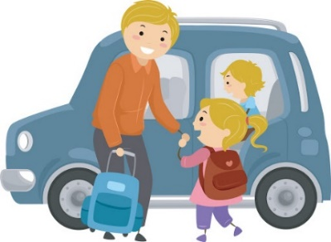
Whole school
581
50
63
3
199
313

Slide 24
Winning Class – Reception and KS1
80
4
9
0
32
20
BIRCH

Slide 25
Winning Class – Year 3/4
69
5
1
16
3
46
Maple

Slide 26
Winning Class Year 5/6
78
2
11
0
9
14
Aspen

