Slide 1
Wow Assembly:
Friday 4th March

Slide 2
Green Cards!
Phoebe - Willow

Slide 3
Scientists of the Week!
Oak –Isla
Ash – Mia
Birch –
Pine – Jaycee
Elm – Jaeden
Willow – Roux
Spruce –
Maple –
Redwood – Natalia
Chestnut –
Aspen- Eva

Slide 4
Weekly Team Points!
Peel | Ethelfleda | Grazier | Offa
190 | 205 | 180 | 206

Slide 5
Oak
Brody
For
Always showing kindness towards other people
and for having a positive attitude towards learning.
Mrs Laffan 04.03.22

Slide 6
Ash
Ralphie
For working very hard and concentrating to complete a mosaic goose.
Miss Bailey and Mrs Salt 04.03.22

Slide 7
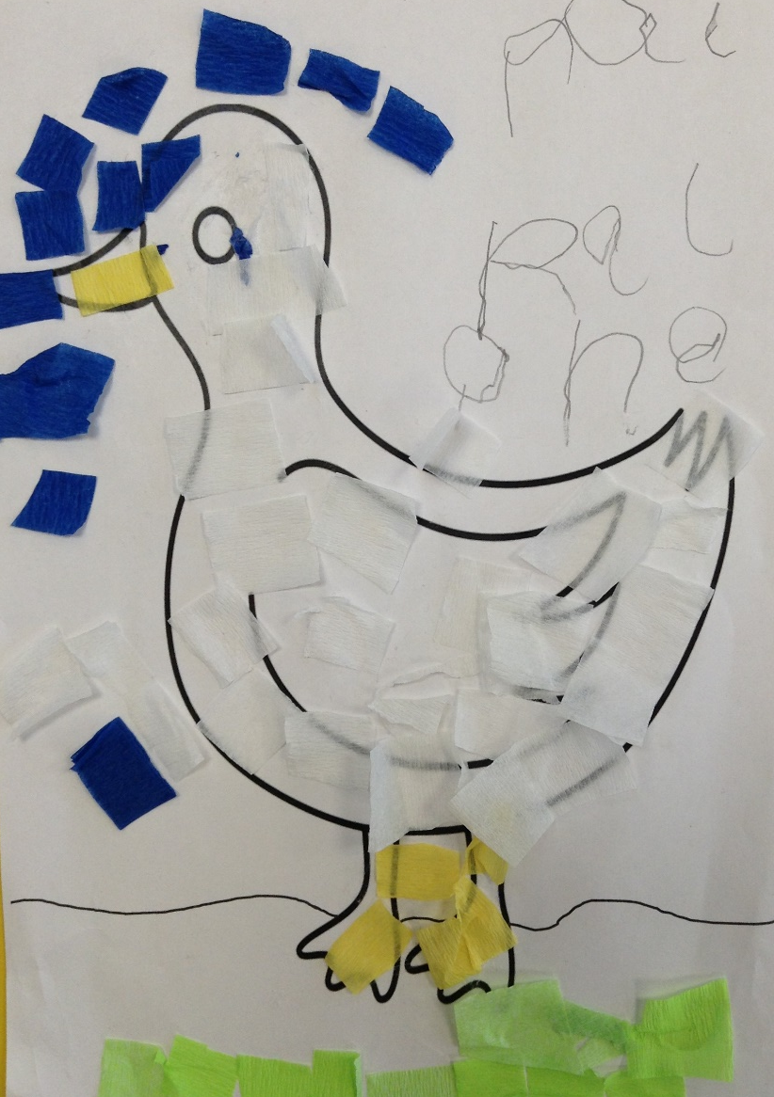
Ash Wow Work

Slide 8
Elm
Charley
During world book day we explored the work of Nick Sharratt. Charley reflected the style of Nick Sharratt beautifully within her own illustrations for our English text – The Enormous Turnip.
Great work Charley!
Mr Grice 04.03.2022

Slide 9
Birch
For
Daisy
On world book day we looked at the work of Nick Sharratt. Daisy followed his step-by-step guides to draw cartoon images. She then applied his style to draw an illustration for her written retell of The Enormous Turnip. Great drawing skills Daisy! Well done! ☺
Miss Hewitt 04.03.22

Slide 10
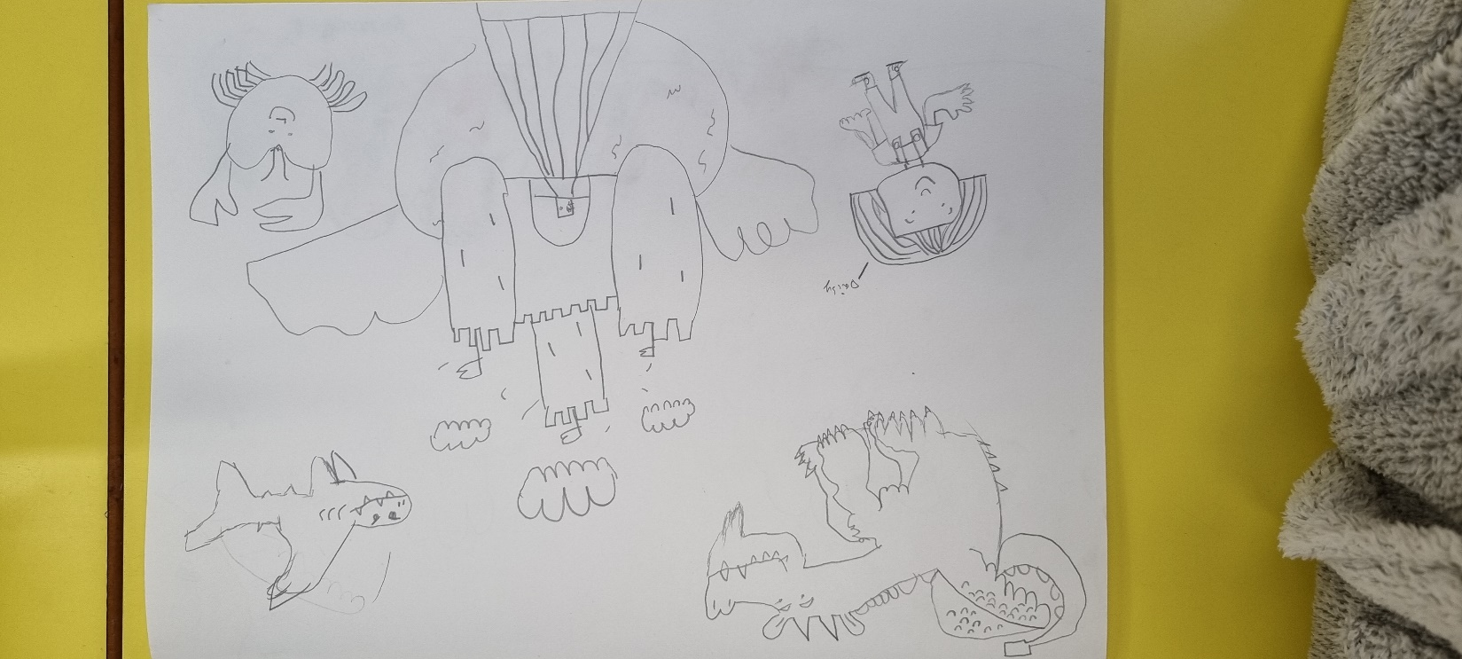
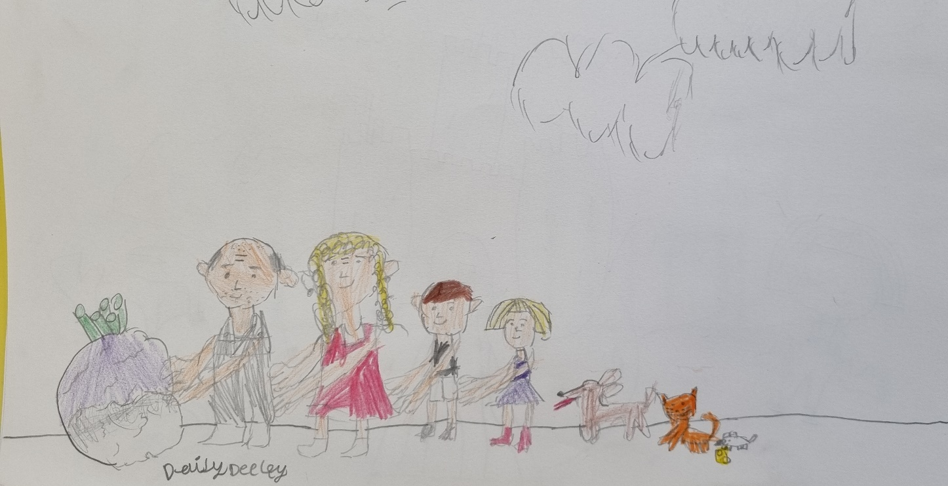
Birch Wow Work

Slide 11
Pine
Liylie
For using resilience and excellence joining our Pine class team. Welcome to year one in Pine. We are so happy to have you. ☺
Mrs Leedham-Hawkes 4.03.22

Slide 12
Maple
Frankie
For sketching different expressions in the style of Nick Sharratt.
Miss Dawson 4.03.2022

Slide 13
Willow
Phoebe
For the wonderful use of her sketch book to gather ideas for the illustration of her poem.
Miss Fisher 04.03.22

Slide 14
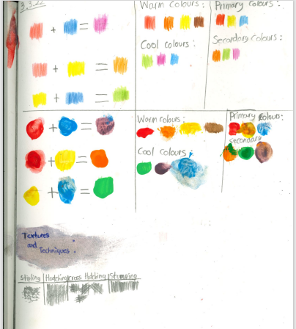
Willow Wow Work

Slide 15
Spruce
Lucy G
For a wonderful use of colour when exploring shade and tints whilst drawing a volcano.
Mr Draper 04.03.22

Slide 16
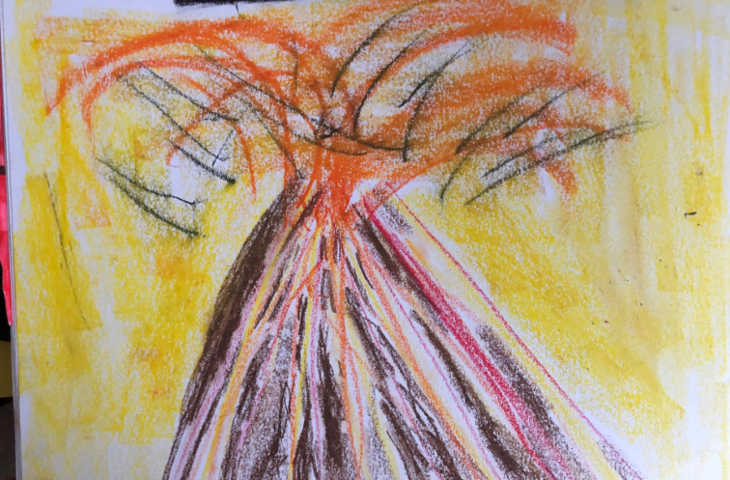
Spruce Wow Work

Slide 17
Chestnut
Jake
For returning to learning this week with a positive attitude and demonstrating confidence towards the different and new subjects taught.
Mr Tennuci 4.3.22

Slide 18
Aspen
Lilly Cks
For showing amazing creativity and perseverance to create characters in the style of Nick Sharratt.
Mrs Read & Miss Bennett 3.3.22.

Slide 19
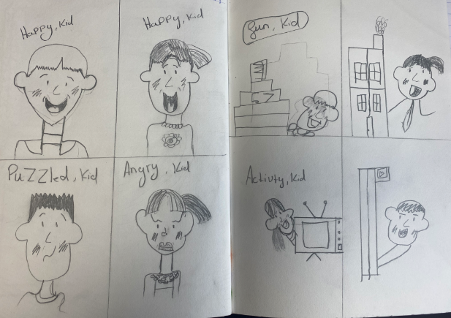
Aspen Wow Work

Slide 20
Redwood
Amelia
For demonstrating an amazing attitude to her work ALL week and taking on new challenges with positivity. I am so proud of how hard she has worked – keep up the fabulous work!
Miss Shipley 04.03.21

Slide 21
