Slide 1
Wow Assembly:
Friday 6th May

Slide 2
Phrase of the Week:
"Do more than belong: participate. Do more than care: help. Do more than believe: practice."

Slide 3
Green Cards!
Aimee J – Chestnut
Amelia B – Chestnut
Amira S – Chestnut
Reilly T – Chestnut
Charlie A - Chestnut

Slide 4
Scientists of the Week!
Oak –Lincoln
Ash –
Birch –
Pine – Rocco
Elm – Layla
Willow –
Spruce –Elyza
Maple –
Redwood – Amelia
Chestnut – Amelia M
Aspen - Eva

Slide 5
Weekly Team Points!
Peel | Ethelfleda | Grazier | Offa
72 | 56 | 65 | 89

Slide 6
Oak
Casper
For
For using the correct mathematical vocabulary to explain his answers in maths.
Mrs Laffan 6.5.22

Slide 7
Ash
Halle
For super independent writing.
Miss Bailey and Mrs Salt 06.05.22

Slide 8
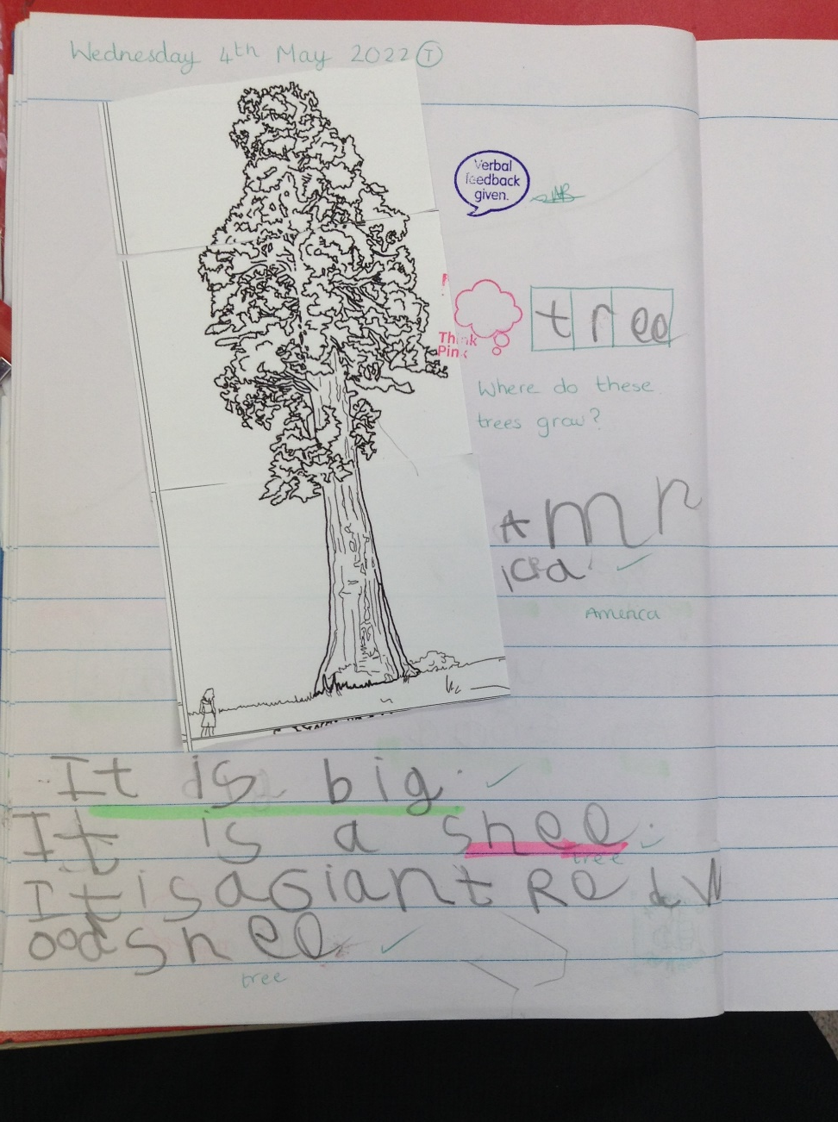

Slide 9
Elm
Celia
For a super attitude towards learning especially in Reading, with Celia often choosing to pick up a book and read. Keep up the excellent reading Celia ☺
Mr Grice 06.05.2022

Slide 10
Birch
Tymon
For
having an amazing attitude to learning. Tymon is making super progress in maths. Keep up the hard work Tymon! Very proud of you!
Miss Hewitt 06.05.22

Slide 11
Pine
Freddie.C
For using perserverance to follow instructions to make bread using the Great Fire of London Bakery recipe.
Mrs Leedham-Hawkes 06.05.22

Slide 12
Maple
Amelia S.
For writing an amazing letter to Philippe Petit. Amelia included some fantastic vocabulary and a range of sentence structures. Well done.
Miss Dawson 06.05.2022

Slide 13
Willow
Roux
For showing excellence when narrating his groups drama performance. You verbalised the story really well and added in how the character was feeling. Keep up the great work.
Miss Fisher 06.05.22

Slide 14
Spruce
Isabel, Elizabeth and Faith
For an amazing drama performance in English, such great passion, communication and teamwork.
Miss Volante 06.05.22

Slide 15
Chestnut
Amelia B
Her writing has been brilliant this week. She has written a fantastic inspirational speech as a future king of England to inspire her army, before marching into battle.
Mr Tennuci 6.5.22

Slide 16
Aspen
Amber
For using wonderful personification and
Similes within her Battle of Bosworth writing.
Miss Bennett & Mrs Read 06.05.2022

Slide 17
Redwood
Caeden F
For writing and delivering a wonderful battle speech as if he were at the Battle of Bosworth
Miss Shipley 06.05.22

Slide 18
Next Week’s
Phrase of the Week:

