Slide 1



Wow Assembly:
Friday 20th November

Slide 2
Phrase of the Week:
The quickest way to fail is not to try.

Slide 3
Green Cards!
Codi-Lee – Ash
Sonny – Ash
Sophie- Willow
Scarlet - Willow

Slide 4
Scientists of the Week!
Oak –Freya
Ash - Adam
Birch – Elyza
Pine – Harley
Willow – Kacey
Spruce – Anaya
Redwood – Izzy
Chestnut – Jake D
Aspen- Jake

Slide 5
Weekly Team Points!
Peel | Ethelfleda | Grazier | Offa
159
169
152
159

Slide 6
Oak
Nikola
For superb independent writing!
Mrs Laffan 20/11 /20

Slide 7
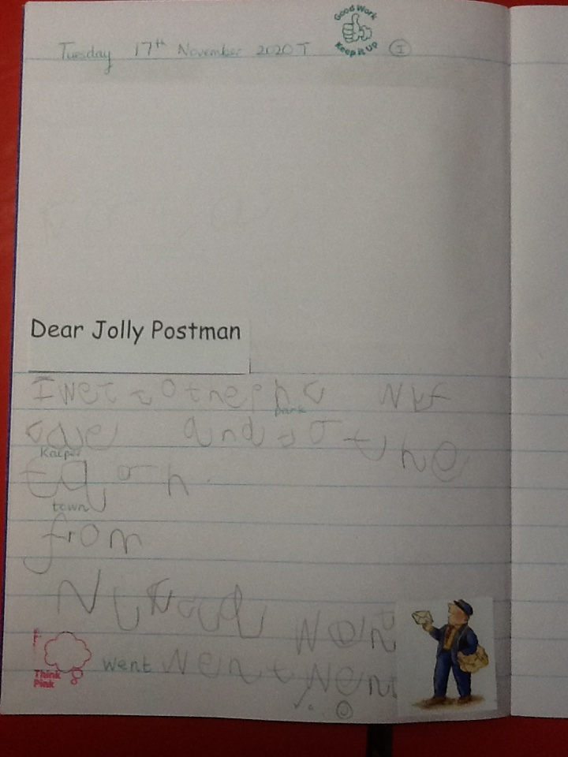
Oak Wow Work

Slide 8
Ash
Amelia
For superb independent writing!
Miss Bailey 20/11/20

Slide 9
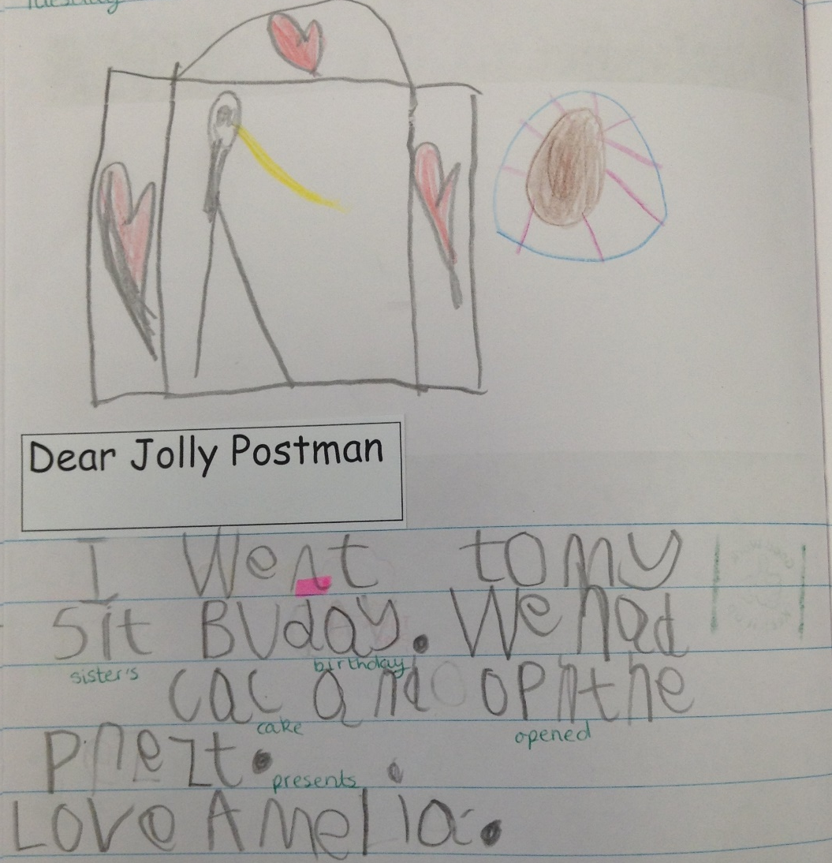
Ash Wow Work

Slide 10
Elm
Remy C
For
Being a fantastic role model for all around school; always showing kindness and empathy towards others.
Miss Brady 20/11 /20

Slide 11
Elm Wow Work
Remy always shows kindness in and around school. This week I have seen Remy show all RESPECT values in many different ways. From tidying the classroom, to helping people in class or on the playground Remy is always thinking of others. Well done Remy, we love having you in Elm class! ☺
RESPECT

Slide 12
Birch
Lucy G
For
A superb piece of art work. Lucy has used colour to show emotion when drawing a portrait. We have been looking at the work of Picasso!
Miss Hewitt 20/11/20

Slide 13
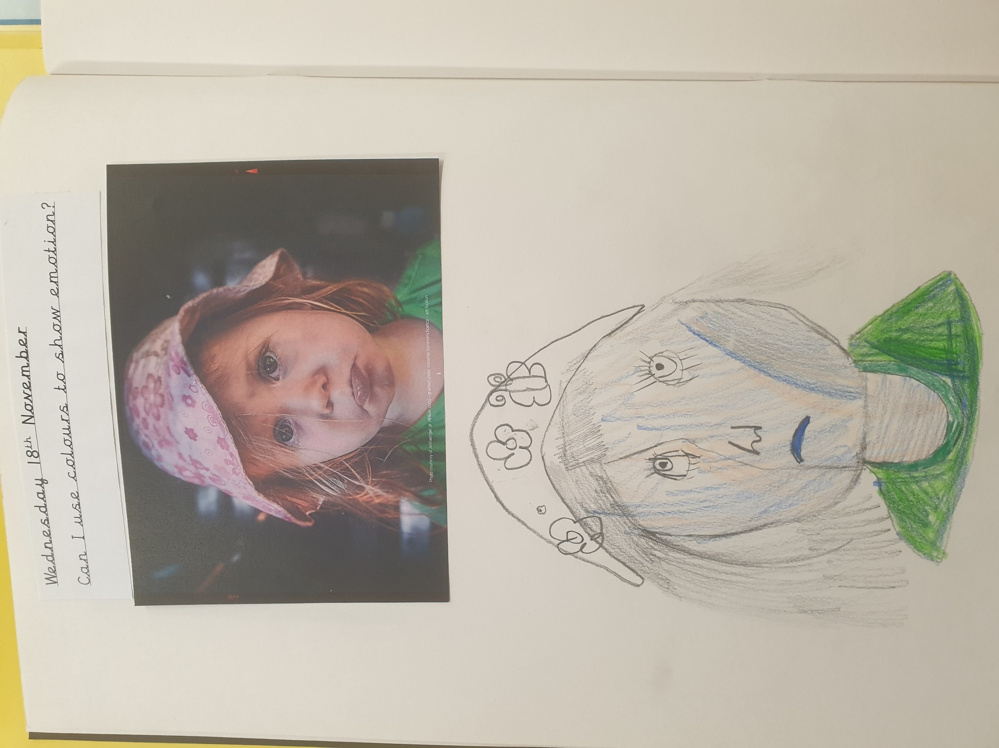
Birch Wow Work

Slide 14
Pine
Harrison
For using resilience to solve a mathematical problem of finding half of a quantity in different ways. Well done! ☺
Mrs Leedham-Hawkes 20/11 /20

Slide 15
Pine Wow Work

Slide 16
Willow
Evelyn
For creating some super artwork at home ☺
Mrs Maiden and Miss Higgins 20 /11/20

Slide 17
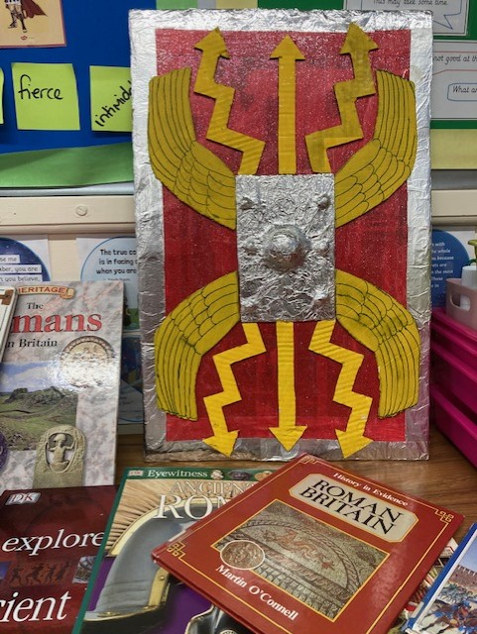
WillowWow Work
Evelyn has made a superb Roman Shield at home as an extra homework project.
We love how much effort you have put into this Evelyn. Well done ☺

Slide 18
Spruce
Keira
For
Having a great attitude towards her work this week which was reflected in both her English and Maths work.
Well Done!
Mr Tennuci 20 /11/20

Slide 19
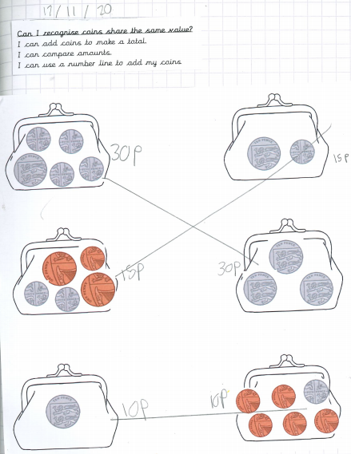
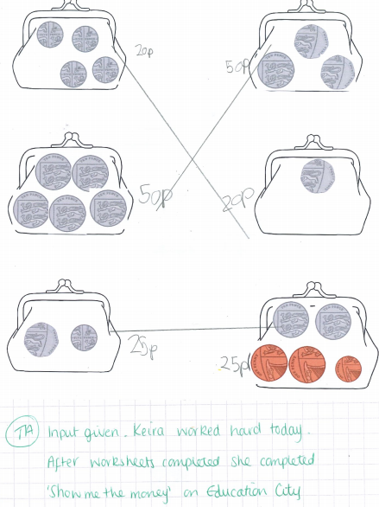
Spruce Wow Work

Slide 20
Chestnut
Amelia
For brilliant resilience when completing work on rounding decimals. Amelia was able to complete the task independently and was able to tackle and solve any problems that she came across. Well Done!!
Miss Fisher 19 /11 /20

Slide 21
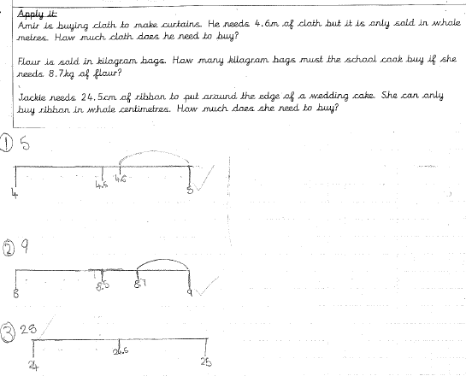
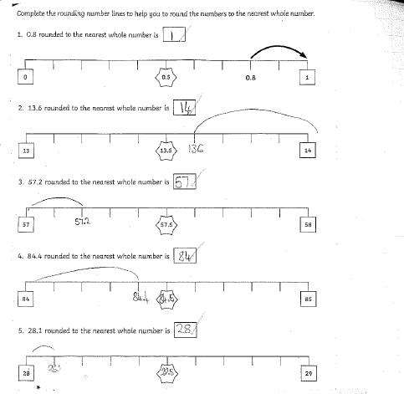
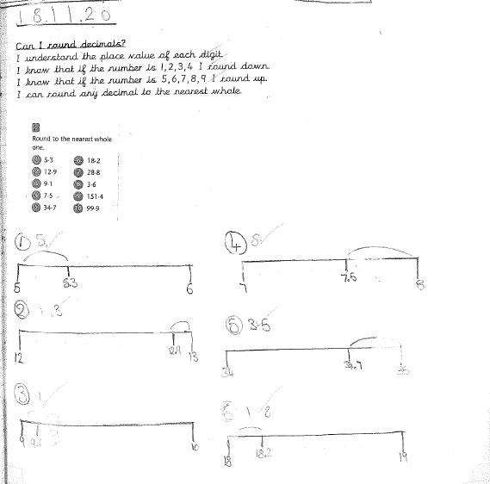
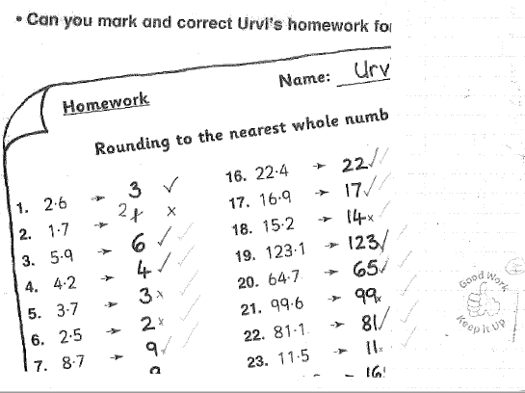
Chestnut Wow Work

Slide 22
Aspen
Freya
For showing perseverance and excellence when calculating percentages of amounts. Go girl!
Mrs Davies 20/11 /20

Slide 23
Redwood
Amelia
For excellent work and effort in learning and applying the rules of speech in writing
Miss Shipley 20 /11 /20

Slide 24
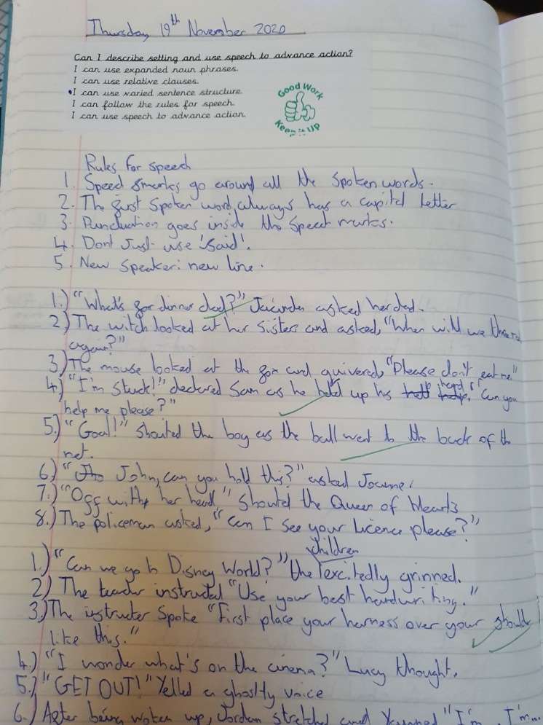

Redwood Wow Work

Slide 25
Next Week’s
Phrase of the Week:
Worry is like a rocking horse:
it passes the time but gets you nowhere.

