Slide 1
Wow Assembly:
Friday 26th November

Slide 2
Green Cards!
Kade – Aspen Maple - Brandon
Amelia B – Chestnut Maple - Oscar
Charlie D – Chestnut
Redwood – Millie
Maple – David
Maple – Phoebe
Maple - Eppie

Slide 3
Scientists of the Week!
Oak –
Ash –
Birch – Callum
Pine – Freddie. C
Elm – Daisy
Willow – Kody
Spruce – Tobias
Maple – Dexter
Redwood – Jay
Chestnut – Zac
Aspen- Jake

Slide 4
Weekly Team Points!
Peel | Ethelfleda | Grazier | Offa
298 | 322 | 353 | 350

Slide 5
Oak
Alice
For
Writing a fantastic letter to Santa.
Mrs Laffan 26.11.21

Slide 6
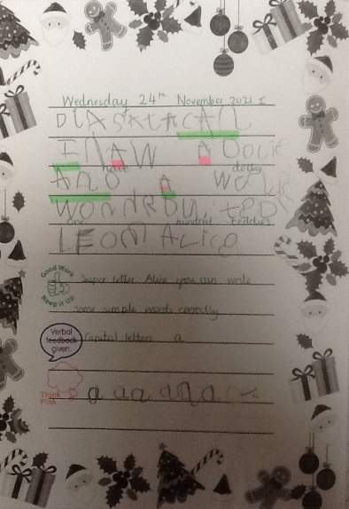
Oak Wow Work

Slide 7
Ash
George
For showing resilience in the face of a challenge when the building blocks kept falling. He found other ways to balance the blocks and created a robot successfully by thinking about the shape of the blocks and how they would balance.
Miss Bailey and Mrs Salt 26.11.21

Slide 8
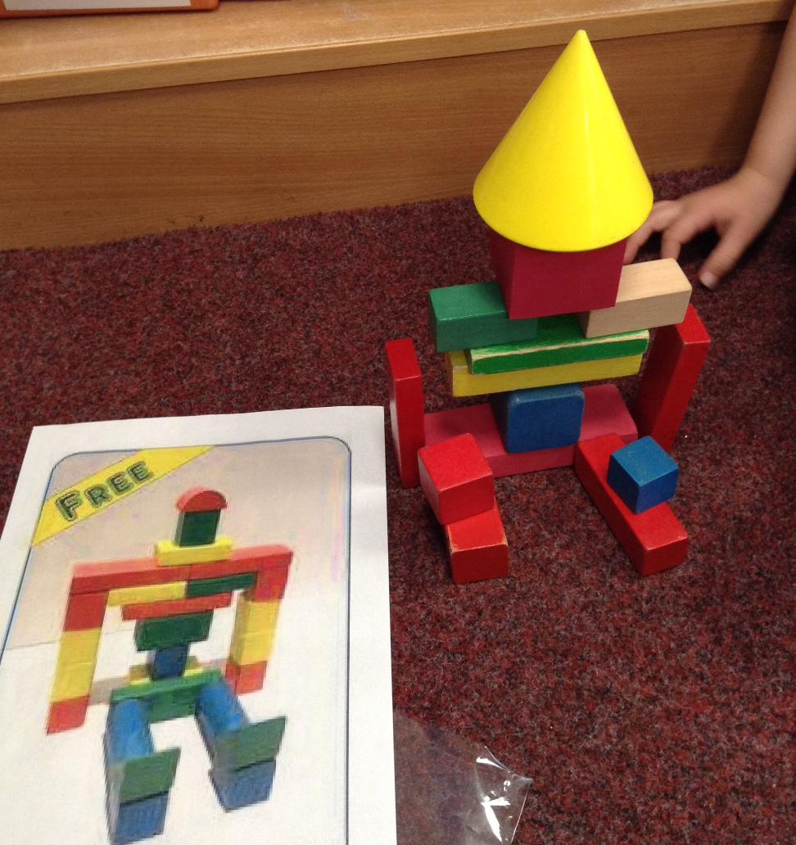
Ash Wow Work

Slide 9
Elm
Jaeden
For showing resilience in PE. Jaeden was able to use the inside of his foot when dribbling. Well done.
Mr Grice 26.11.2021

Slide 10
Birch
For
Poppy
For having a fantastic attitude to learning her nativity lines and pushing herself out of her comfort zone to sing a solo performance. ☺
Miss Hewitt 26.11.21

Slide 11
Pine
Harley
For using excellence in word reading knowledge. Harley read all year one common exception words and nearly all of year two common exception words! Harley is in year one. So proud!
Mrs Leedham-Hawkes 26.11.21

Slide 12
Maple
Alyssa
For working extremely hard in maths and showing resilience when faced with difficult problems.
Miss Dawson 26.11.2021

Slide 13
Willow
Roux
For persevering with his maths and always trying his best.
Miss Fisher 26.11.2021

Slide 14
Spruce
Kia E
For brilliant reasoning and perseverance in maths, striving for excellence with each step of your learning.
Mr Draper 26.11.2021

Slide 15
Chestnut
Charlie D.
His written work has developed very well over the last few weeks and with different styles of writing as well. This week, he has worked hard to make better and interesting choices with his vocabulary, to engage his reader, with his use of personification to describe a setting.
Mr Tennuci 26.11.21

Slide 16
Aspen
Sophia G
For pushing herself to include varied sentence structures and punctuation in our Guided Reading vocabulary lesson this week. Keep it up! ☺
Mrs Read & Mrs Cox 26.11.21

Slide 17
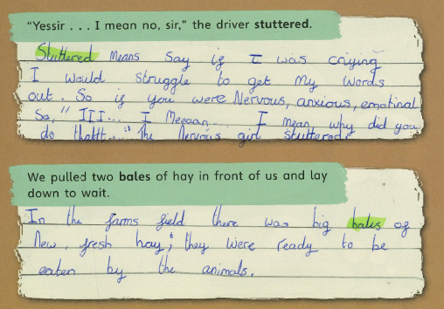
Aspen Wow Work

Slide 18
Redwood
Millie L
For fantastic teamwork and communication skills during our Science practical – making a model of human blood
Miss Shipley 26.11.21

Slide 19
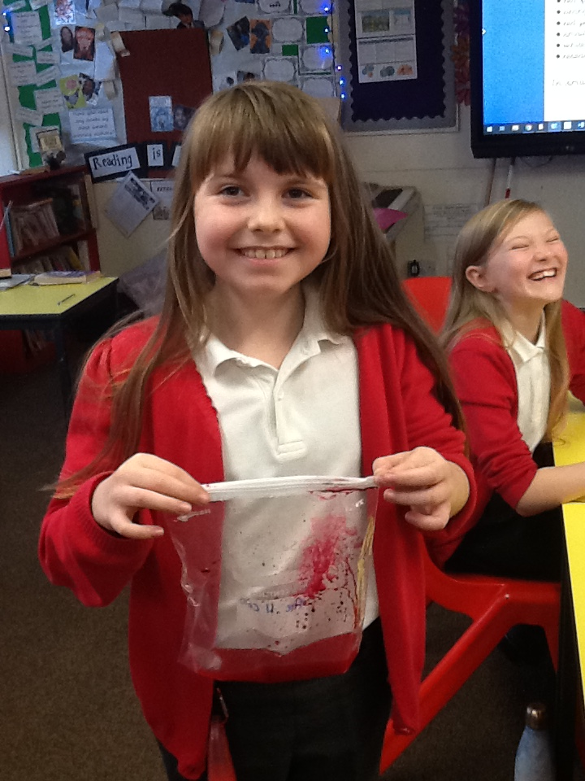
Super encouragement of others
Wonderful sharing of ideas
Excellent discussion

