Slide 1
Wow Assembly:
Friday 11th June

Slide 2
Phrase of the Week:
Education is the most powerful weapon that you can use to change the world.

Slide 3
Green Cards!
Taylor-Oak
Tobias Y- Elm

Slide 4
Scientists of the Week!
Oak – Laura
Ash –
Birch – Oliver J
Pine – Poppy
Elm – Casper
Willow – Tobias
Spruce – Ayla
Maple – Harvey
Redwood – Charlie
Chestnut – Charlie A
Aspen-

Slide 5
Weekly Team Points!
Peel | Ethelfleda | Grazier | Offa
112
68
94
85

Slide 6
Oak
Harriet
For
Super resilience in maths when halving numbers up to 10.
Mrs Laffan 11/6/21

Slide 7
Ash
Alfie
For
Independently creating an underwater picture using his handprint. He chose appropriate colours to create his scene – well done!
Mrs Cox 11.05.21

Slide 8
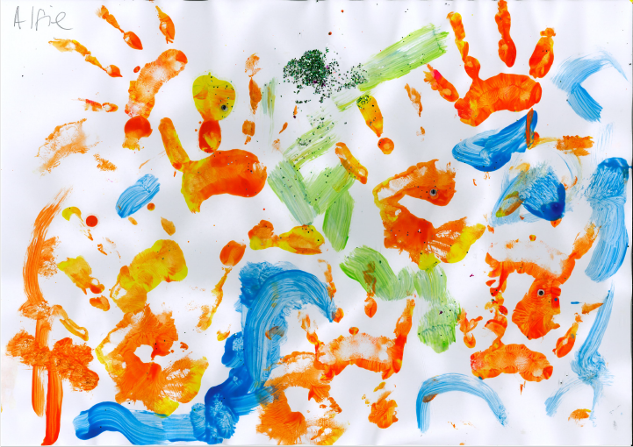
Ash Wow Work

Slide 9
Elm
Tobias
For
A superb piece of writing where Tobias showed passion, resilience, and excellence. Well done Tobias! I am so proud of the work you have achieved.
Miss Brady 10.6.21

Slide 10
Birch
Lucy G
For
Showing resilience and problem solving skills to create 3D shapes using paper straws and pipe cleaners during our STEM challenge starter. Lucy made a fantastic cube and went on to help others demonstrating super communication skills. Well done Luce!
Miss Hewitt 11.06.21

Slide 11
Pine
Darci
For using excellent communication skills to help friendships at playtimes.
Mrs Leedham-Hawkes 11.06.21

Slide 12
Maple
Oliver A
For making careful observations in Science and using specific vocabulary to describe the features of rocks.
Miss Dawson 11.06.2021

Slide 13
Willow
Kyron
For his super effort in English this week.
Building up to his poem he has worked really hard to think of some effective similes, metaphors and expanded noun phrases.
Brilliant all round effort, really proud of you Kyron ☺ Well done!
Mrs Read and Miss Higgins 11.06.21

Slide 14
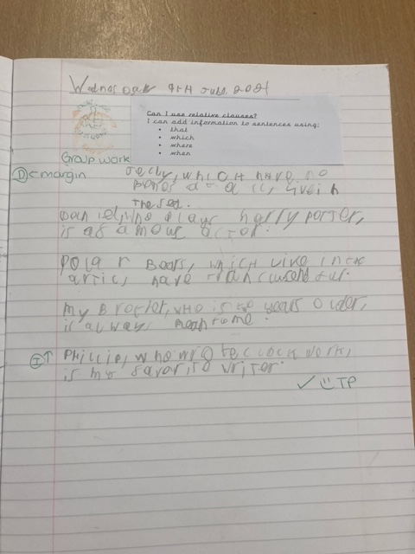
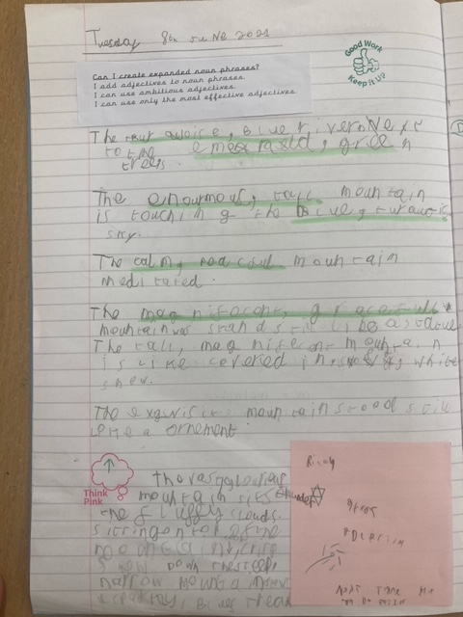
WillowWow Work

Slide 15
Spruce
Amber
For her excellent poetry this week. She has made some thoughtful choices with the vocabulary and features she has learnt and begun to produce an excellent final piece of poetry.
Well done Amber!
Mr Tennuci 11.06.21

Slide 16
Chestnut
Amelia M
For her fantastic work in Maths. Amelia persevered and was resilient when completing work using the four operations and was able to draw on her previously learnt knowledge to help her. Keep up the super work Amelia!
Miss Fisher 11.06.21

Slide 17
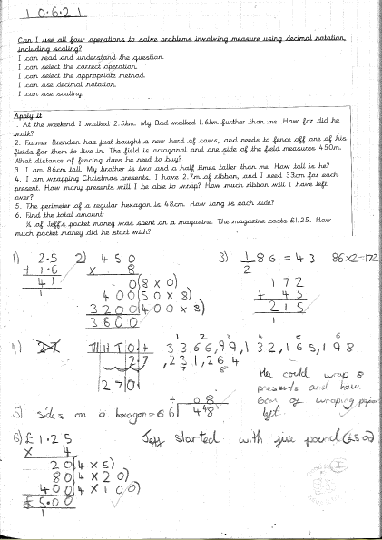
Chestnut Wow Work

Slide 18
Aspen
Miley V
For a fantastic effort in maths. Miley has been able to solve problems involving algebra and has showed resilience when faced with difficult challenges.
Miss Volante 10.06.2021

Slide 19
Redwood
Aimee J.
For outstanding effort and self-awareness in PE! Keep up the fantastic work
Miss Shipley 10.06.21

Slide 20
Next Week’s
Phrase of the Week:
Difficult roads often lead to beautiful destinations. Do not quit!

